Slide 1
WELCOME TO COQ ESPORTS - MOBA
Install MLBB and complete the tutorials.
Complete the survey:- https://docs.google.com/forms/d/e/1FAIpQLSf8wTg6w8Eu4zWxMEOU4PRHh9mlzoyO4EGxjDyDY1Ru4AaQag/viewform
Bind MLBB account with at least 2-tier security from hacking. (via moontoon, email, fb etc)
Follow TARUC_DSA_Esports & TARUMT Interactive Gaming Society facebook.
*Quiz https://docs.google.com/forms/d/e/1FAIpQLSdImDn6B3NgWxR_tJ5f2K5VeEeOAFKZcsvwoPZQNF7i_54ung/viewform

Slide 2
eSports In Malaysia
Ministry of Youth & Sports (KBS) granted initial allocation of RM9.9 million in 2019, followed by RM19.8 million a year later. For 2021, KBS managed to fund RM14.8 million despite pandemic contingency. For 2022, RM20 million and RM13 million for year 2023.
Officially sanctioned at 2019 Philipines SEA Games & 2021 Vietnam SEA Games.
Demonstrated at 2018 Asian Game Palembang, Indonesia.
Officially endorsed as one of the event at 2022 Asian Game HangZhou, China
https://en.wikipedia.org/wiki/Esports_at_the_2022_Asian_Games

Slide 3
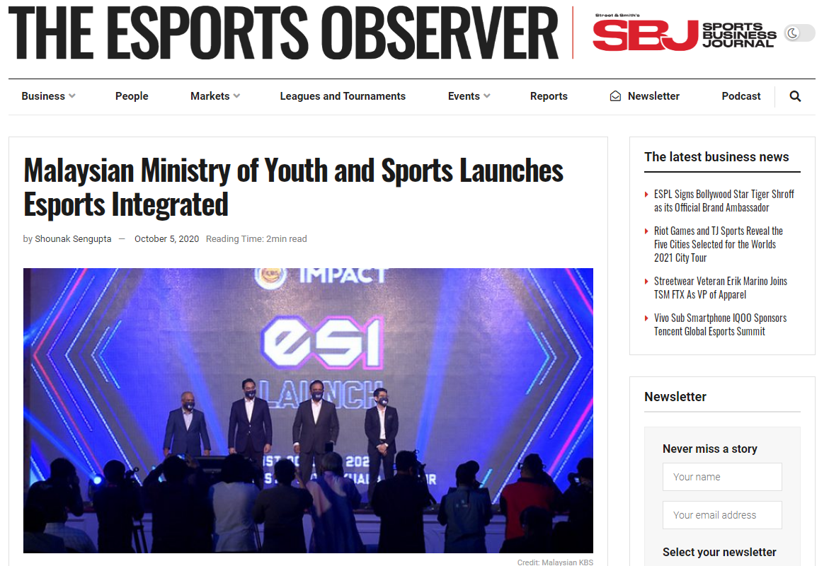

Slide 4
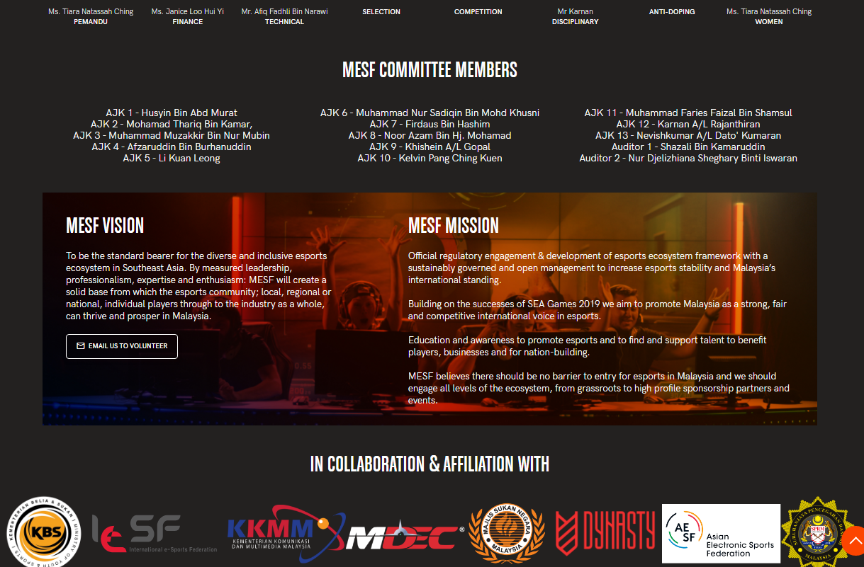
MESF
Malaysia
Esports
Federation

Slide 5
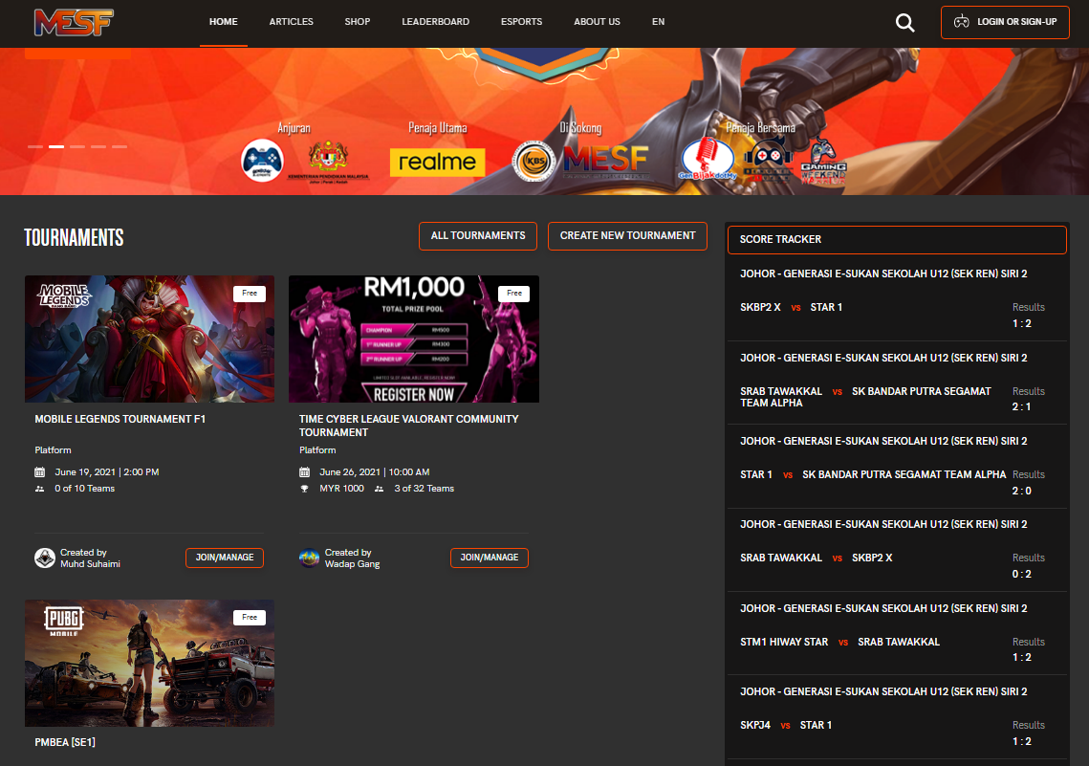

Slide 6


Slide 7
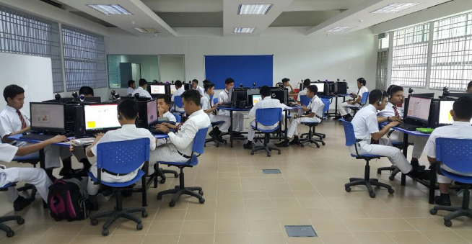

Slide 8
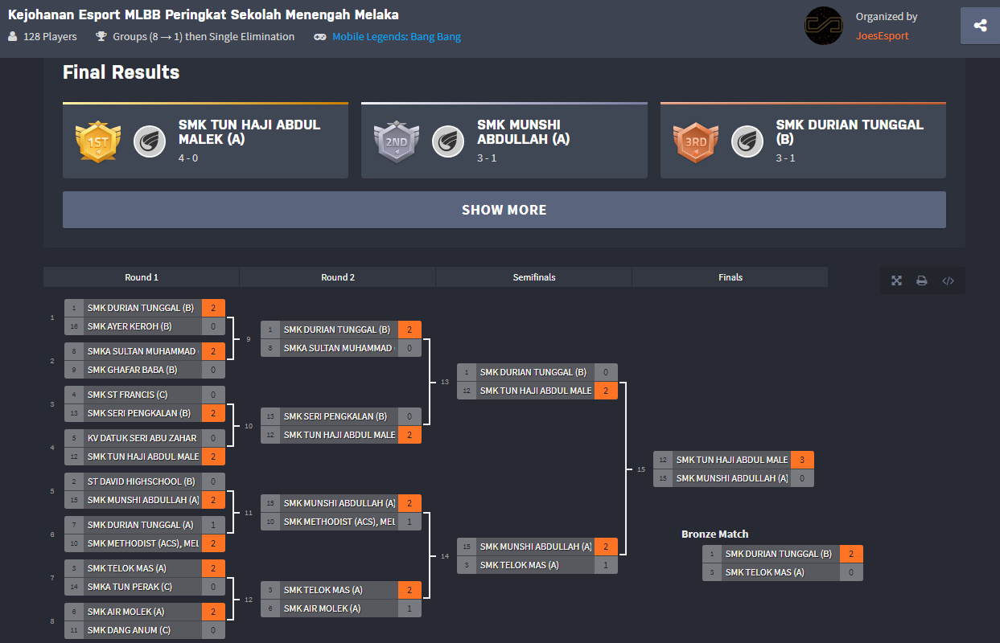
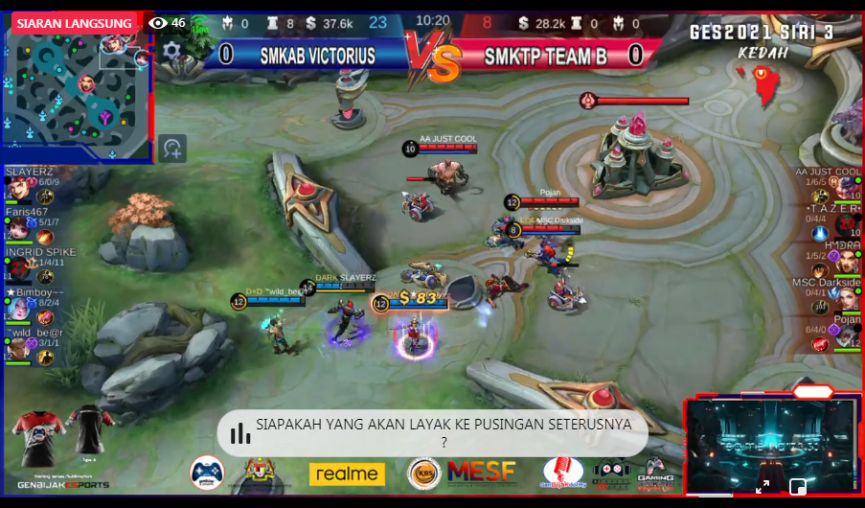

Slide 9
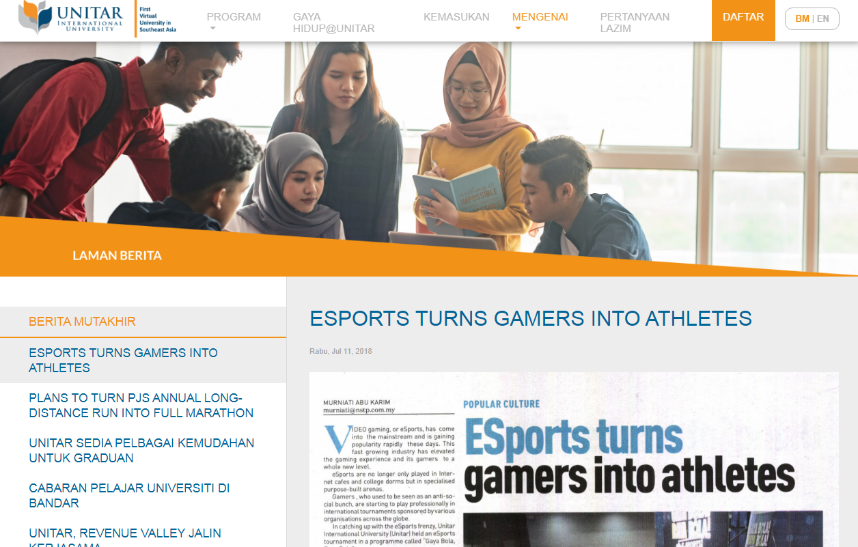

Slide 10
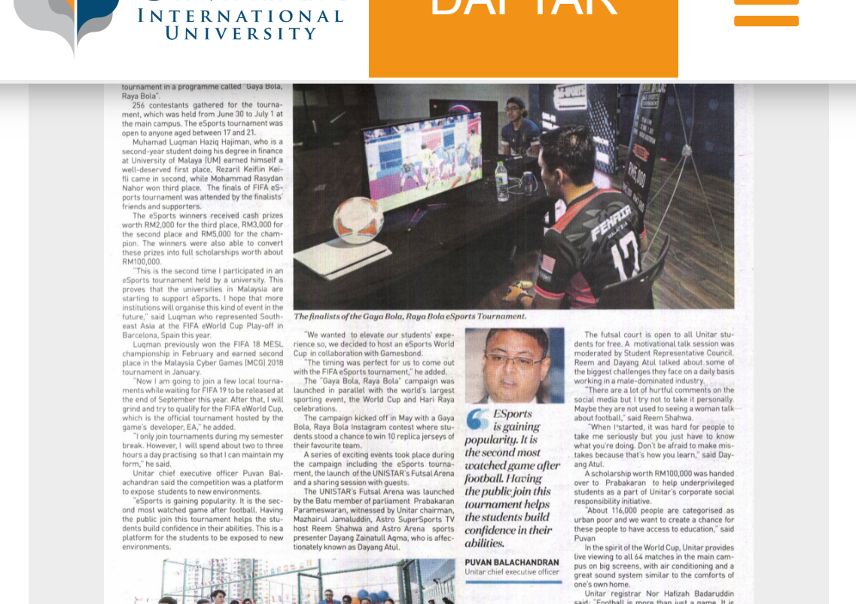

Slide 11
Esports Club/Society in Local IPT
Universiti Teknikal Malaysia Melaka (UTeM) – UTem Gamers Society
Politeknik METrO Kuantan (PMKU) – Kelab E-sukan PMKU
Universiti Monash Malaysia – Monash Esports Club
Universiti SEGi – Gamers Alliance SEGi
Universiti Malaysia Sarawak (Unimas) – UNIMAS Esports
Universiti Tunku Abdul Rahman (UTAR) – UTAR Esports & Game Dev Club (Kampus Sungai Long)
Universiti Selangor (Unisel) – Unisel E-Sports Club – UEC
Universiti Multimedia Malaysia (MMU) – E-Games Club
Universiti Multimedia Malaysia (MMU Cyberjaya) – MMU Esports Club
Universiti Tenaga Nasional (Uniten) – Uniten Esport Club
Universiti Pendidikan Sultan Idris (UPSI) – UPSI Esports Club
INTI International College Kuala Lumpur (INTI KL) – INTI KL Esports Club
INTI International University & Colleges (INTI) – INTI Esports Club

Slide 12
Universiti Curtin Malaysia (Curtin) – Curtin Esports Club
Universiti Islam Antarabangsa Malaysia (IIUM) – IIUM Esports Club
Universiti Tun Hussein Onn (UTHM) – UTHM Esports Club
KDU University College – KDU Esports Club
Universiti Taylor (Kampus Lakeside) – Taylor’s University Esports Club
Universiti Kuala Lumpur (UniKL) – UniKL Esports Club
Sunway University and Sunway College – Sunway Esports Club
Universiti Malaysia Sabah – UMS Esports Club
Management and Science University (MSU) – MSU Esports Club
Universiti Tun Abdul Razak – Unirazak Esports Club
Politeknik Merlimau Melaka – Poly Merlimau Esports Club
Universiti Tunku Abdul Rahman (Kampar) – UTAR Kampar Esports & Game Development Club (UKEC)

Slide 13
UCSI University Malaysia – UCSI Reborn Esport Club
City University – City University Esports Club
University of Southampton Malaysia Campus – USMC Esports Club
UiTM Melaka – UiTM Melaka Esports Club
Universiti Kebangsaan Malaysia (UKM) – UKM Esports Club
Kolej Universiti Poly-Tech MARA – KUPTM Esports Club
TAR UMT (KL) - Interactive Games Society
Korporat :
Petronas – KSRP Esports Club
AirAsia – AirAsia Allstars Esports Club

Slide 14
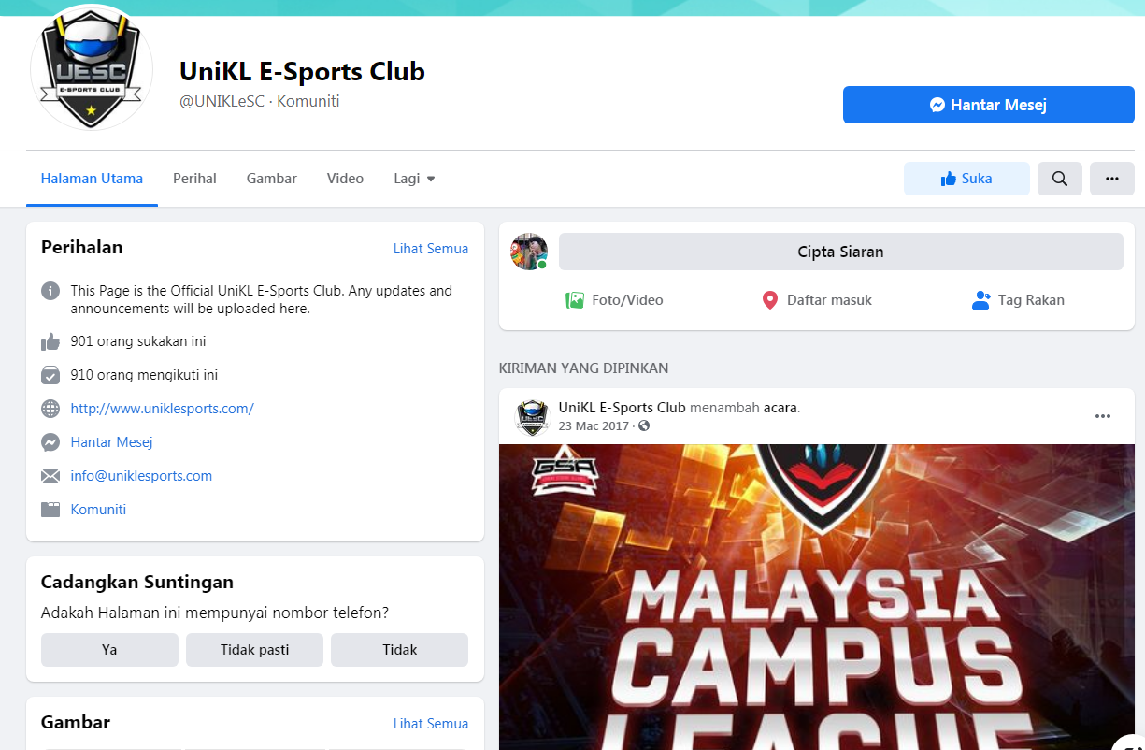

Slide 15
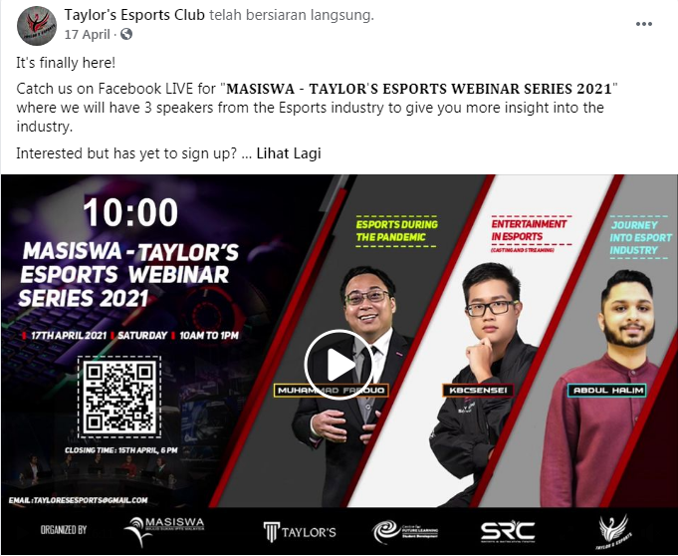

Slide 16
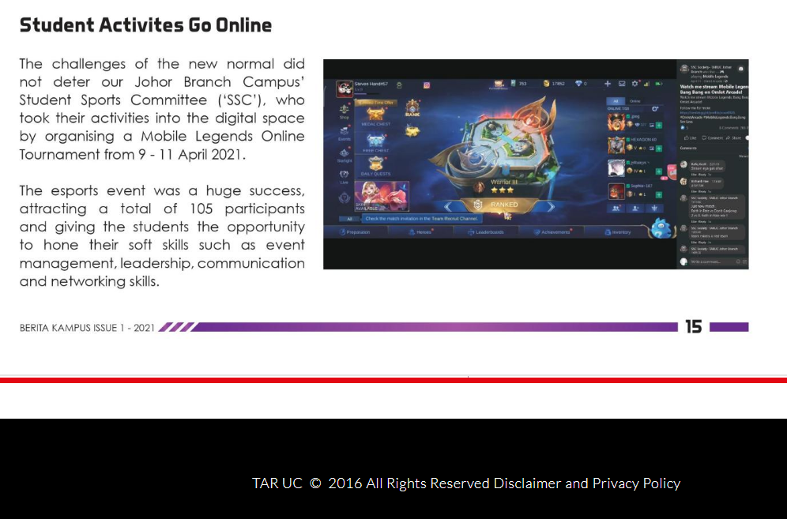

Slide 17
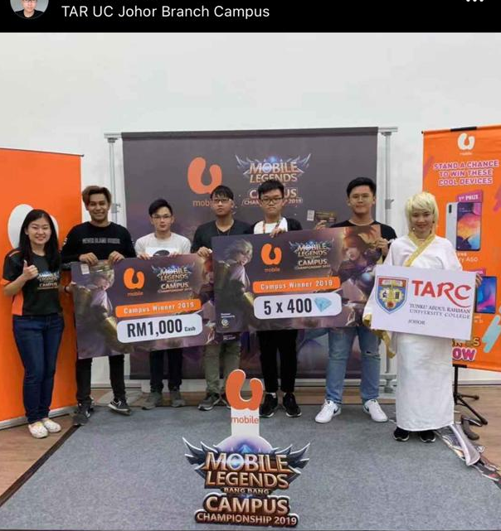

Slide 18
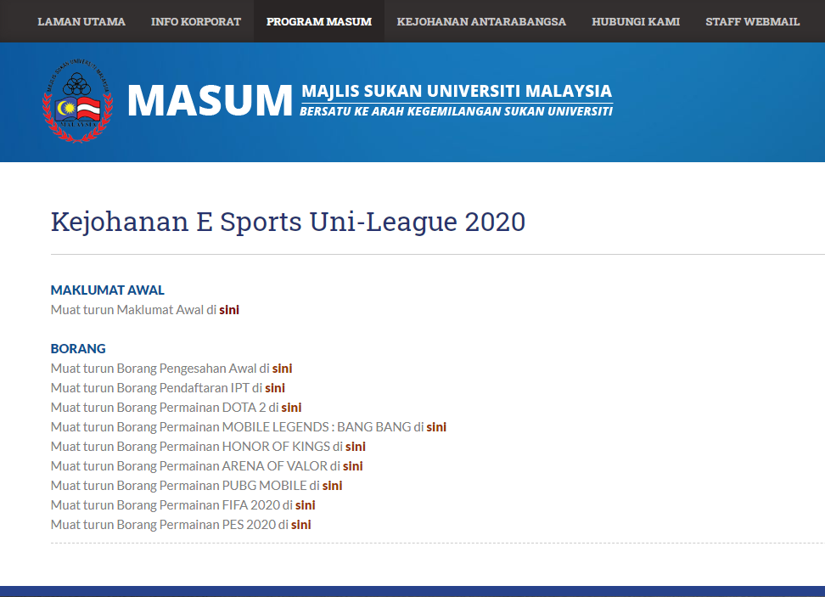

Slide 19
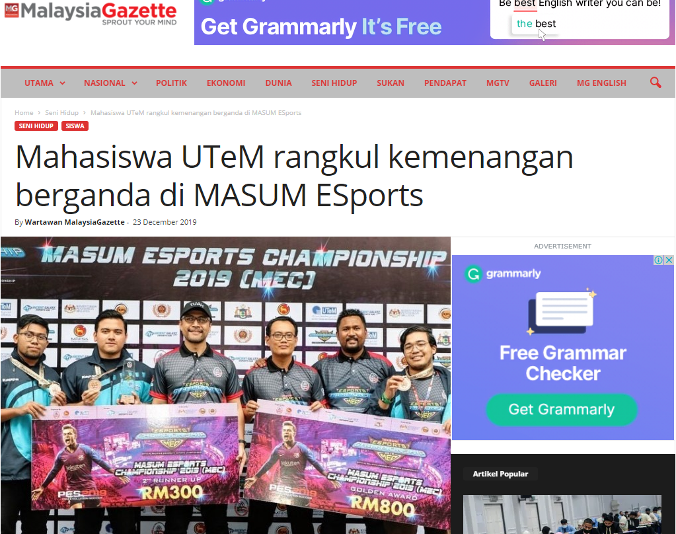

Slide 20
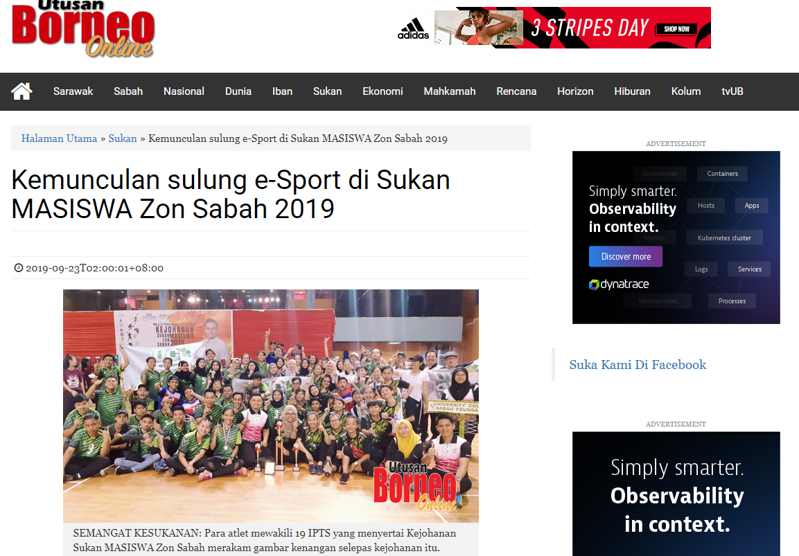

Slide 21
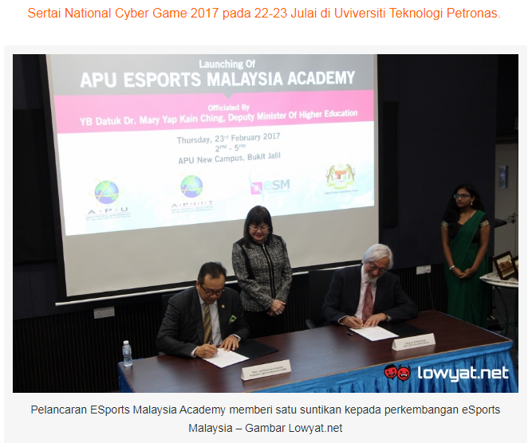

Slide 22
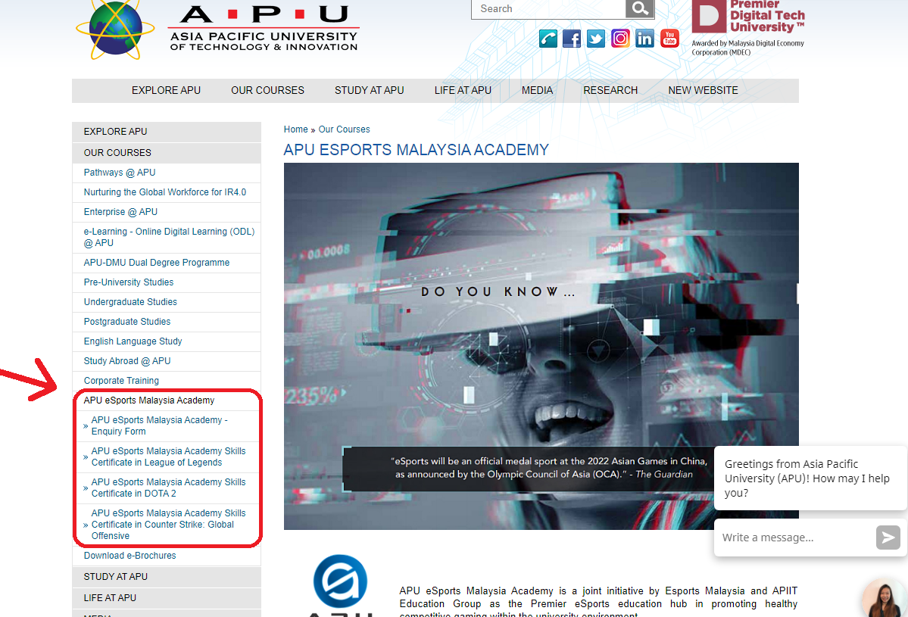

Slide 23
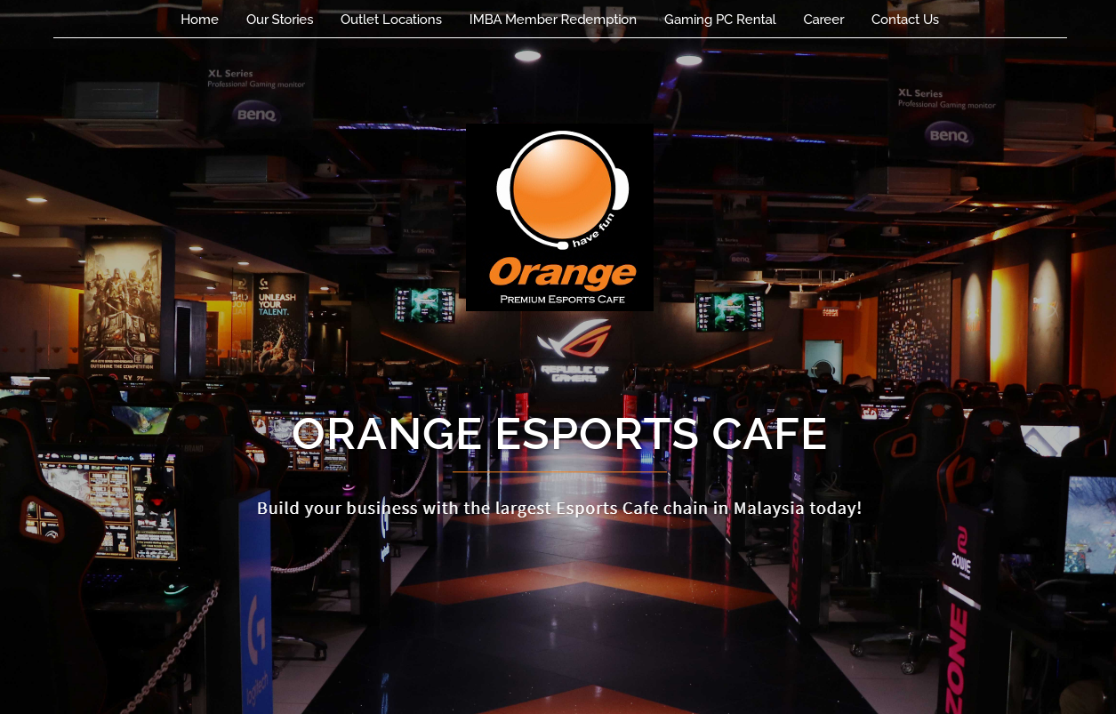

Slide 24
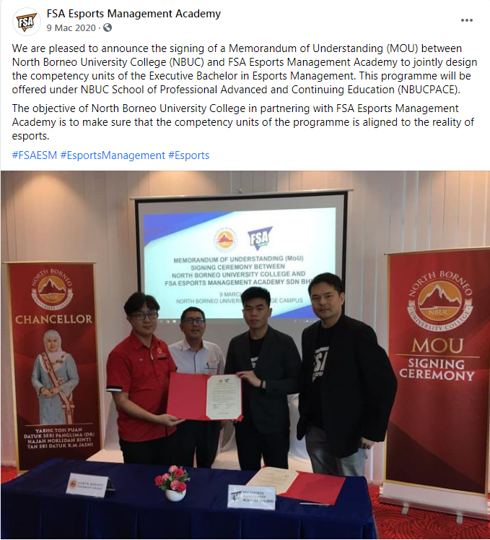

Slide 25
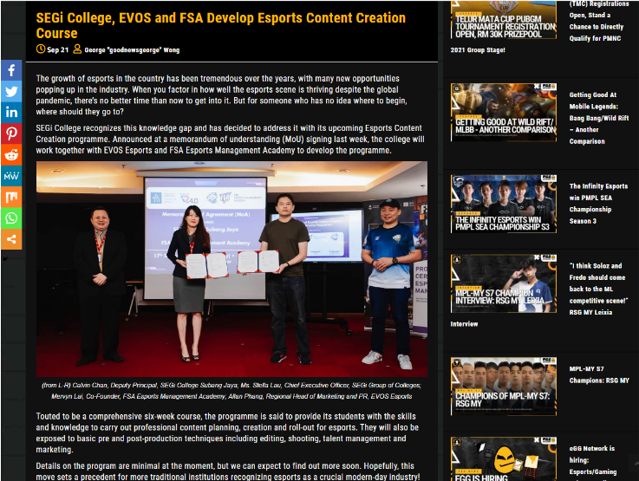

Slide 26
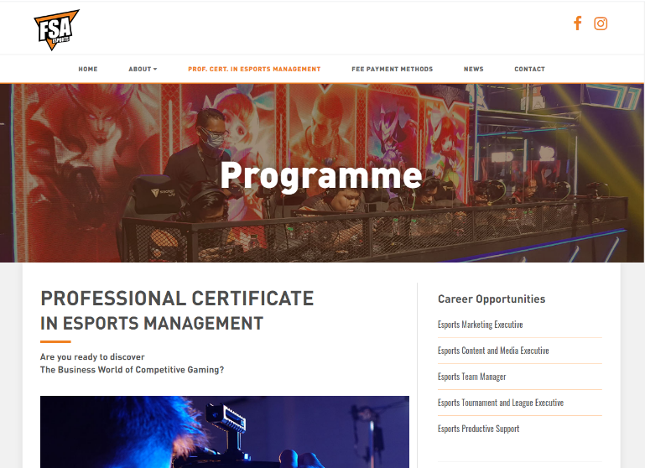

Slide 27
Senarai Universiti Dan Kolej Di Malaysia Yang Tawarkan Kursus Gaming
1. Asia Pacific University of Technology and Innovation (APU)
Bachelor in Computer Games Development
Bachelor in Computer Games Development with Specialism in Games Concept Art.
2. Universiti Pendidikan Sultan Idris (UPSI)
Diploma in Games Design and Development.
3. KDU University College
Bachelor of Game Development (Shah Alam)
Diploma in Games Technology (George Town)
4. Limkokwing University of Creative Technology
Bachelor of Arts (Hons) in Games Art Development
Bachelor of Arts (Hons) in Games Design
BSc. (Hons) In Games Technology
Diploma In Games Art.
5. Multimedia University (MMU)
Bachelor of Multimedia (Hons.) Virtual Reality
Bachelor of Multimedia (Hons.) Animation and Visual Effects
Bachelor of Multimedia (Hons.) Interface Design.

Slide 28
6. Management & Science University (MSU)
Diploma in Games Design and Animation
Bachelor in Games Design and Animation (Hons)
7. Universiti Tunku Abdul Rahman (UTAR)
Bachelor of Arts (Hons) Game Design
Bachelor of Science (Hons) Game Development
8. Clazroom College
Advanced Diploma in Game Design
9. Selayang Community College
Diploma in Games Art.
10. Kolej Poly-Tech MARA Ipoh
Diploma in Game Design
Diploma in Animation
Diploma in Multimedia.

Slide 29
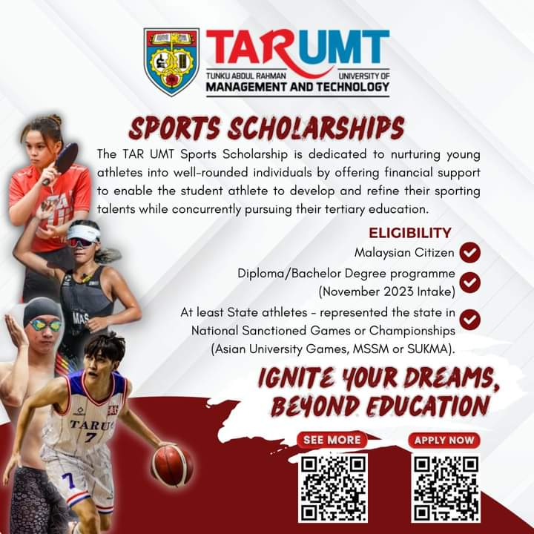
eSports in TAR UMT
1. TARUMT Interactive Software Technology
https://www.tarc.edu.my/focs/programmes/bachelor-degree/bachelor-of-computer-science-honours-in-interactive-software-technology/
2. Establishment of eSports Arena
(formerly known as HERO eSports Arena)
3. Introducing Co-curricular eSports MOBA
programme commenced on 202209
4. Scholarship for high level eSports Athlete
represented state or national.
5. Faculty and university level eSports tournament
such as Inter Faculty /Orientation Sports Day.

Slide 30
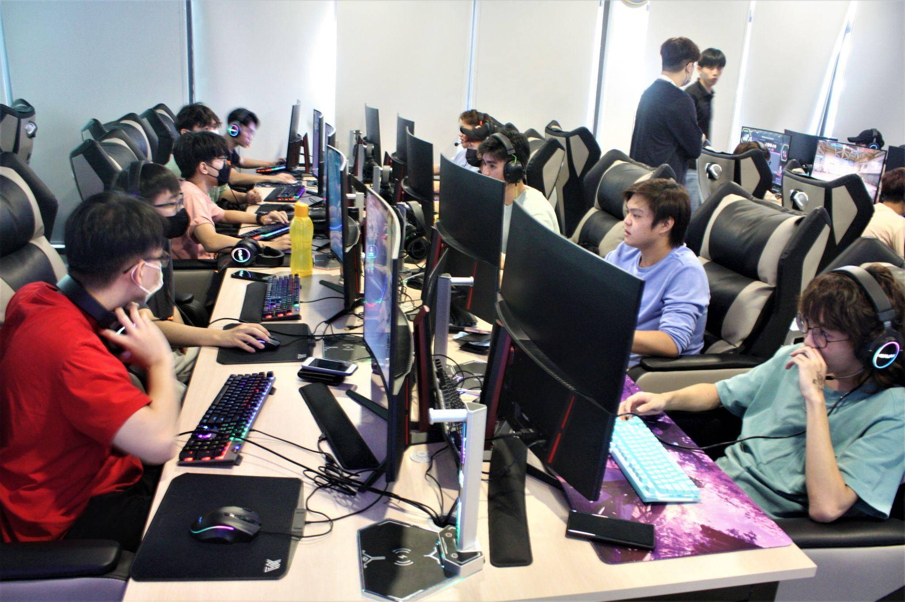

Slide 31
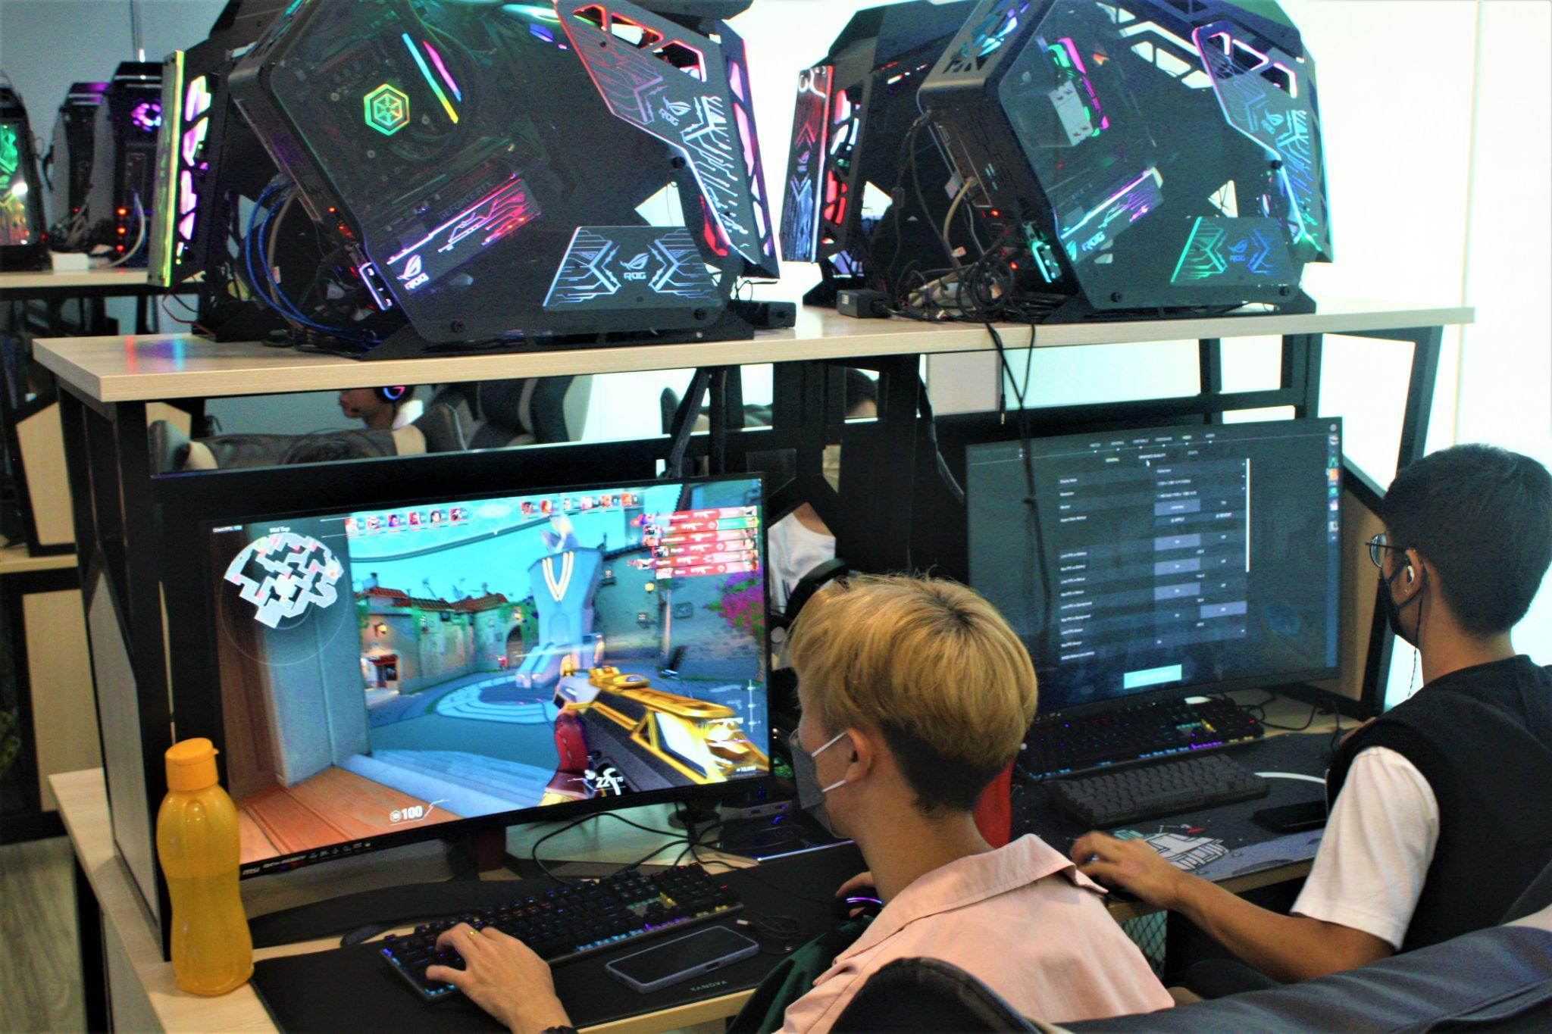

Slide 32
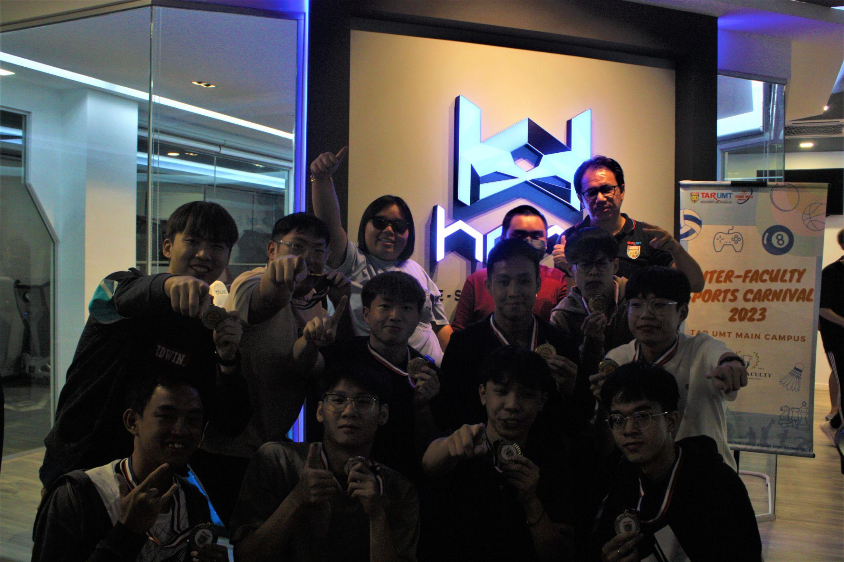

Slide 33
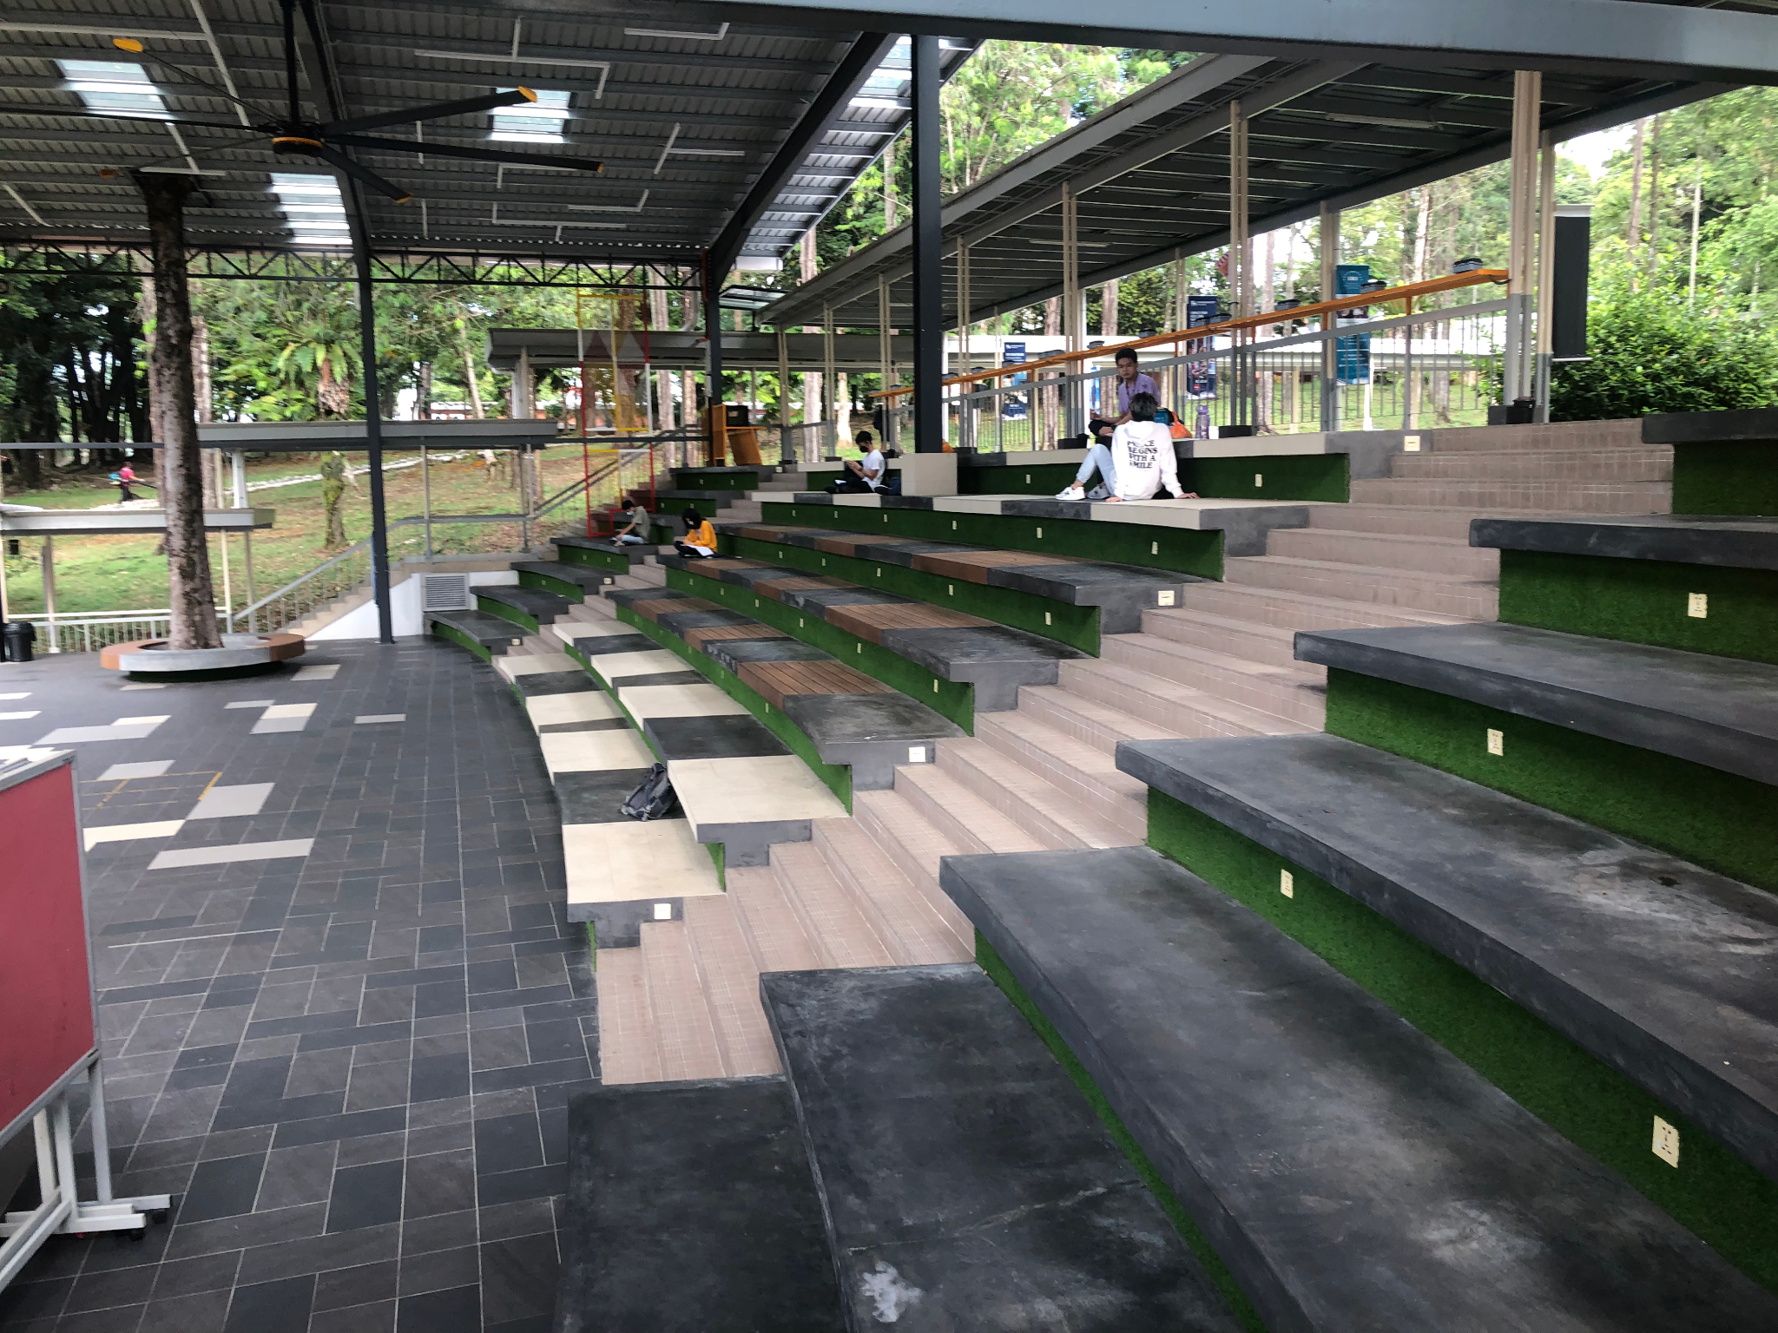

Slide 34
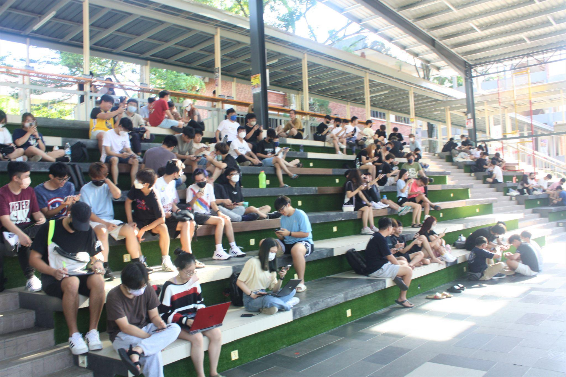

Slide 35
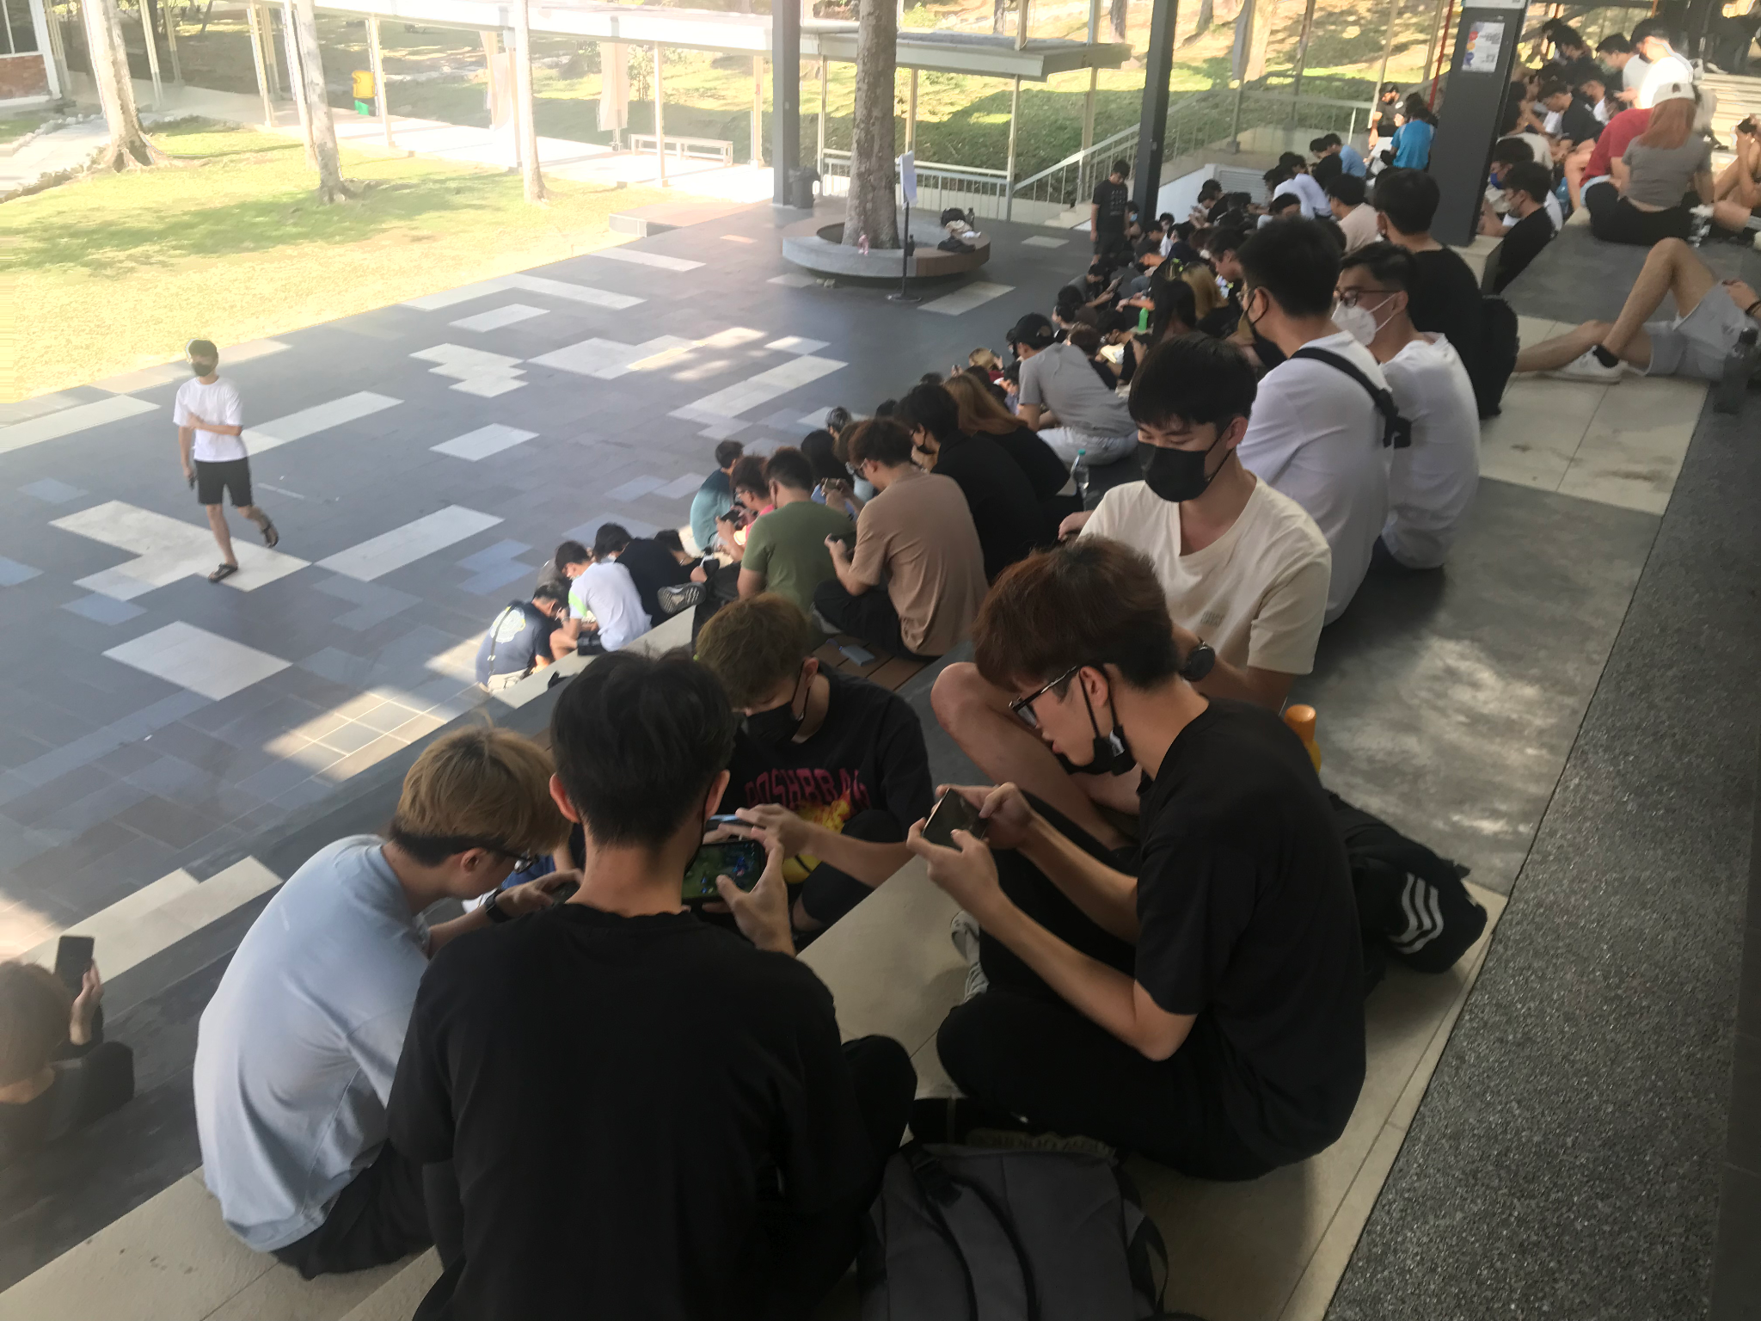

Slide 36
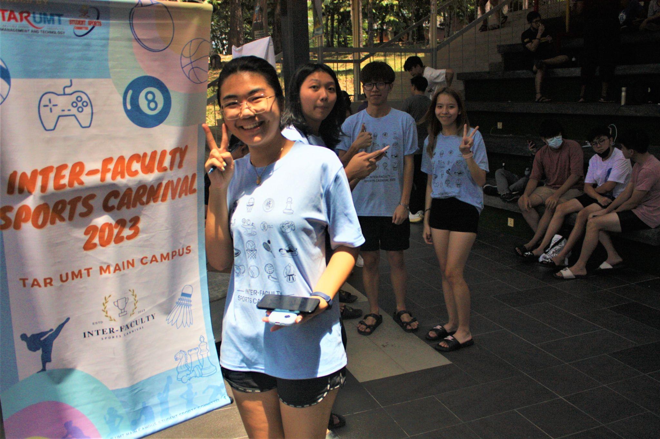

Slide 37
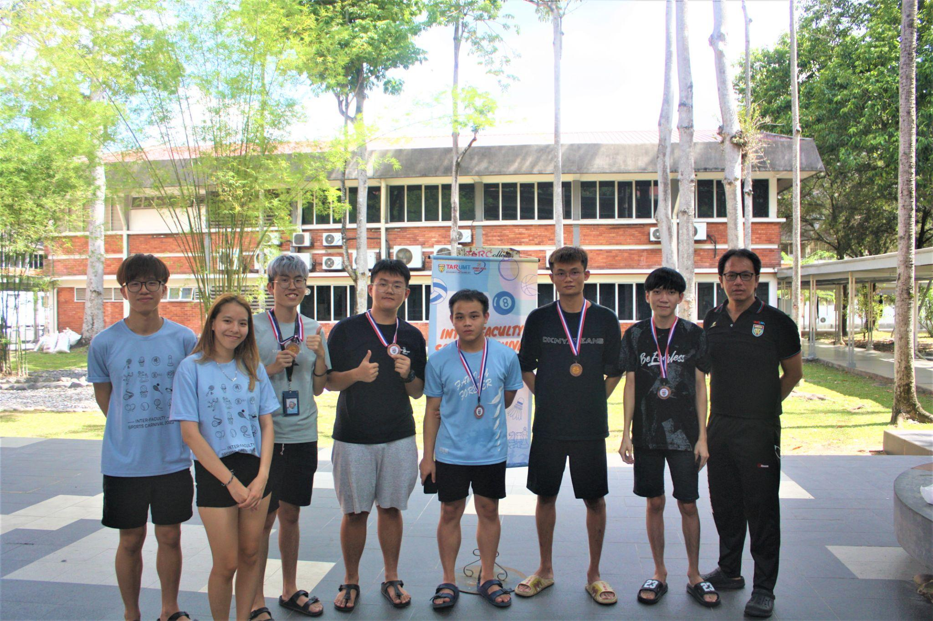

Slide 38
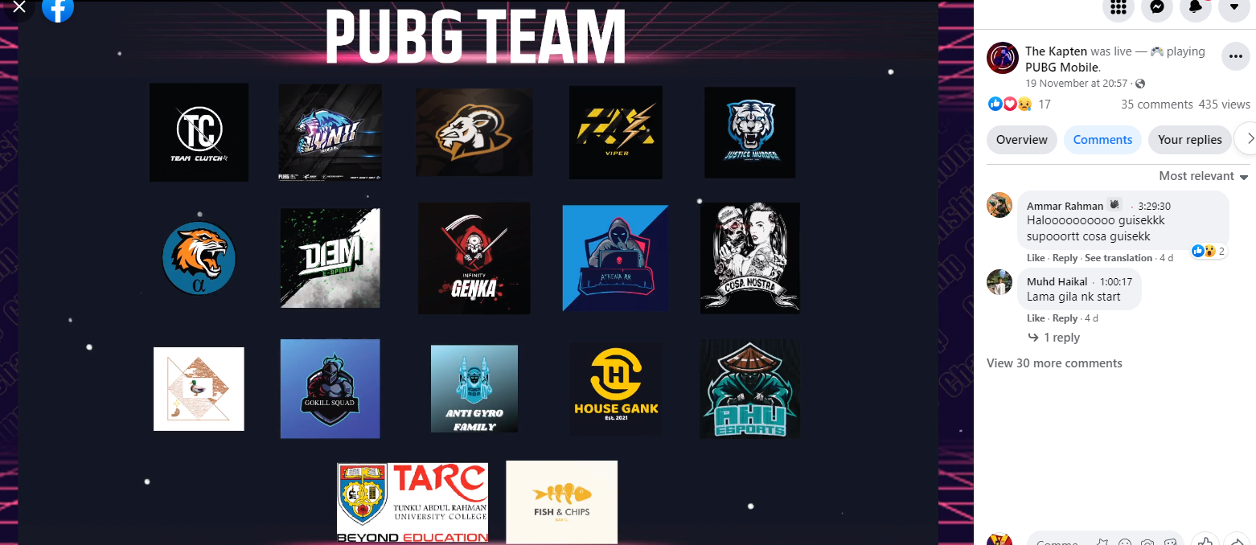

Slide 39
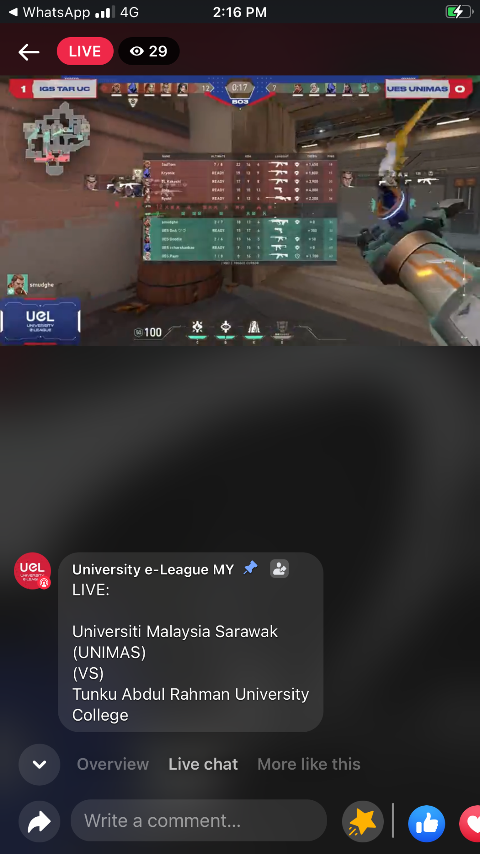
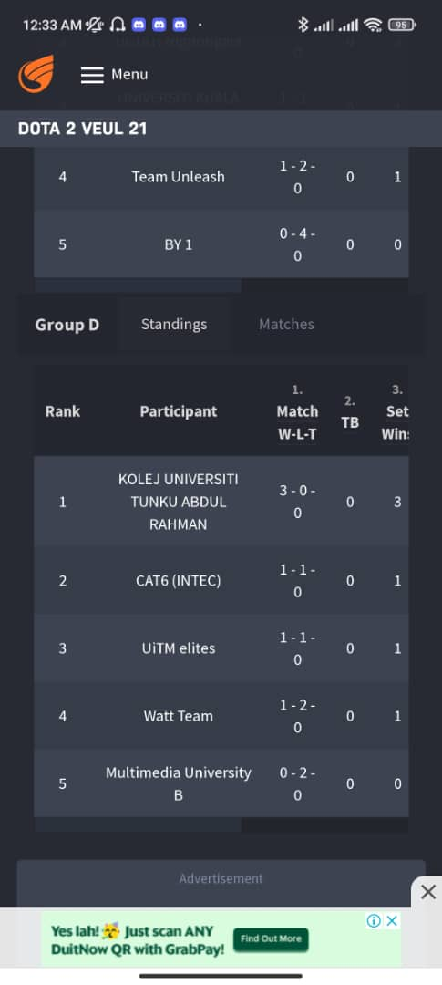

Slide 40
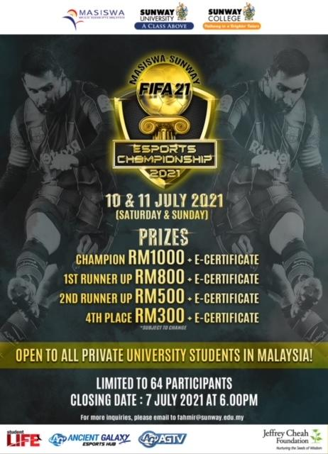

Slide 41
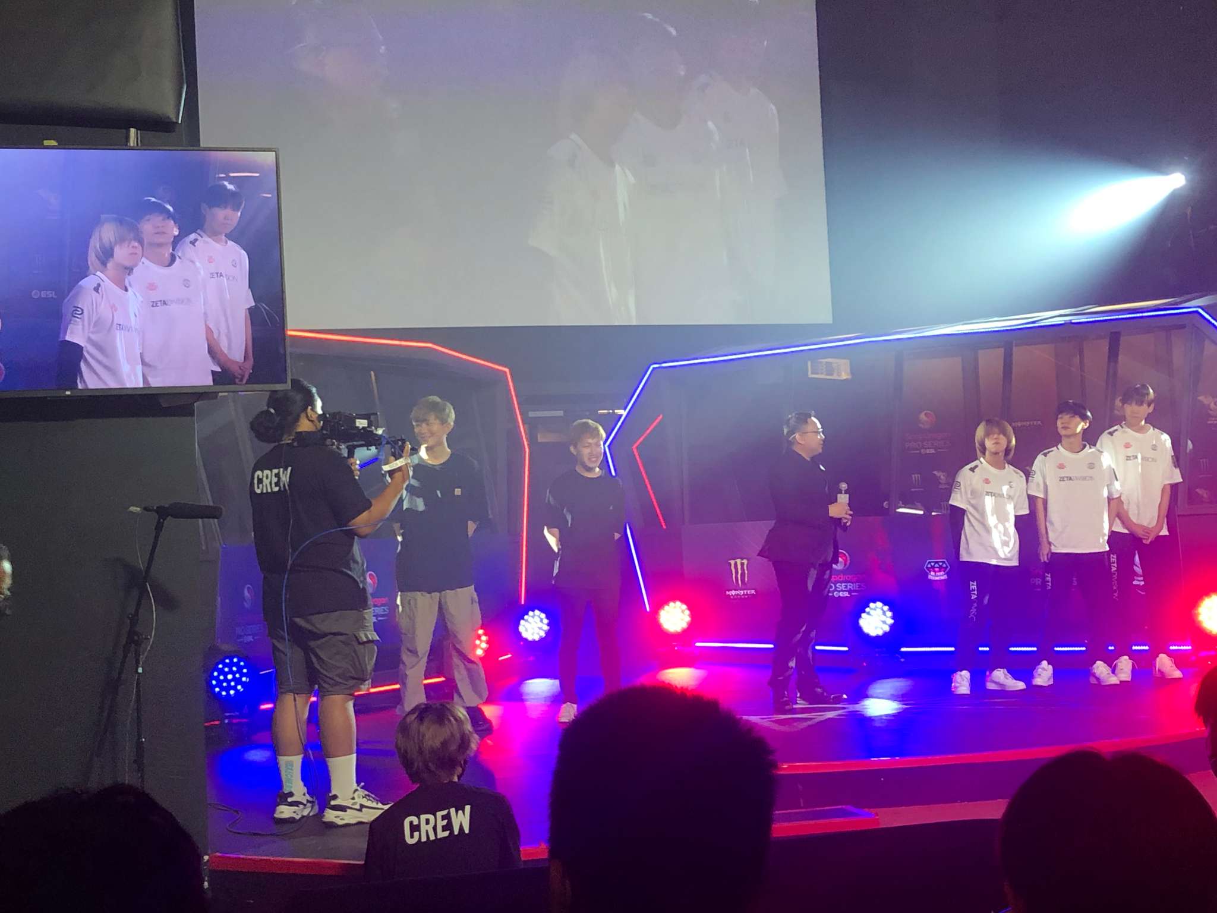

Slide 42
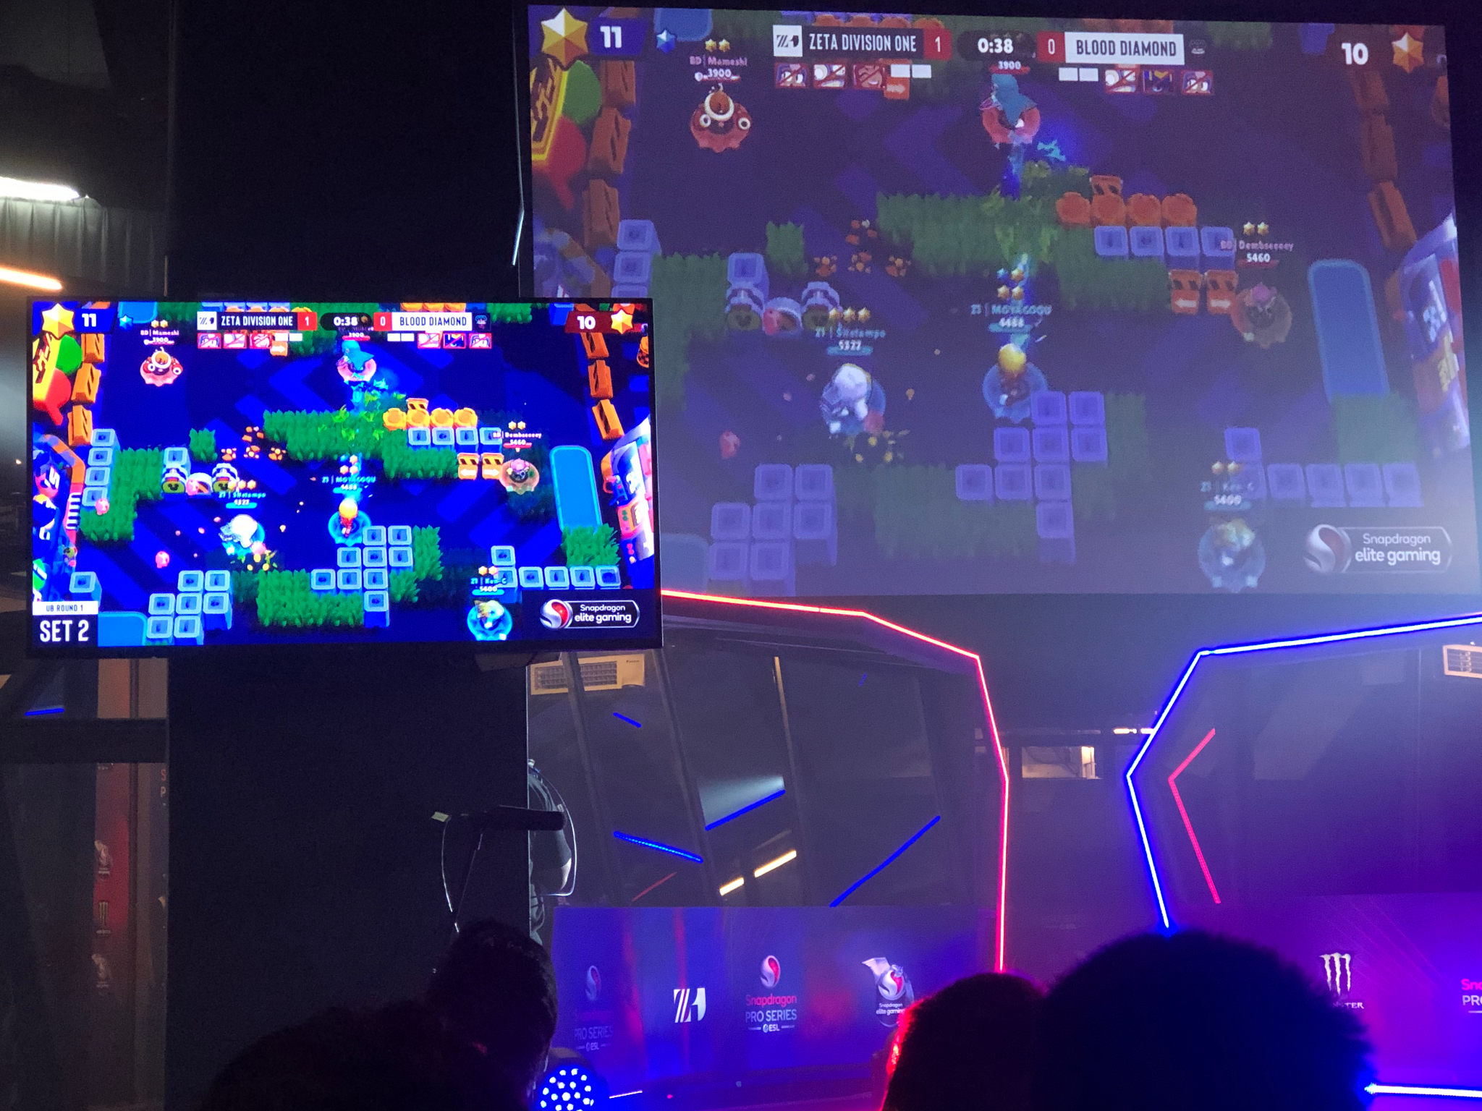

Slide 43
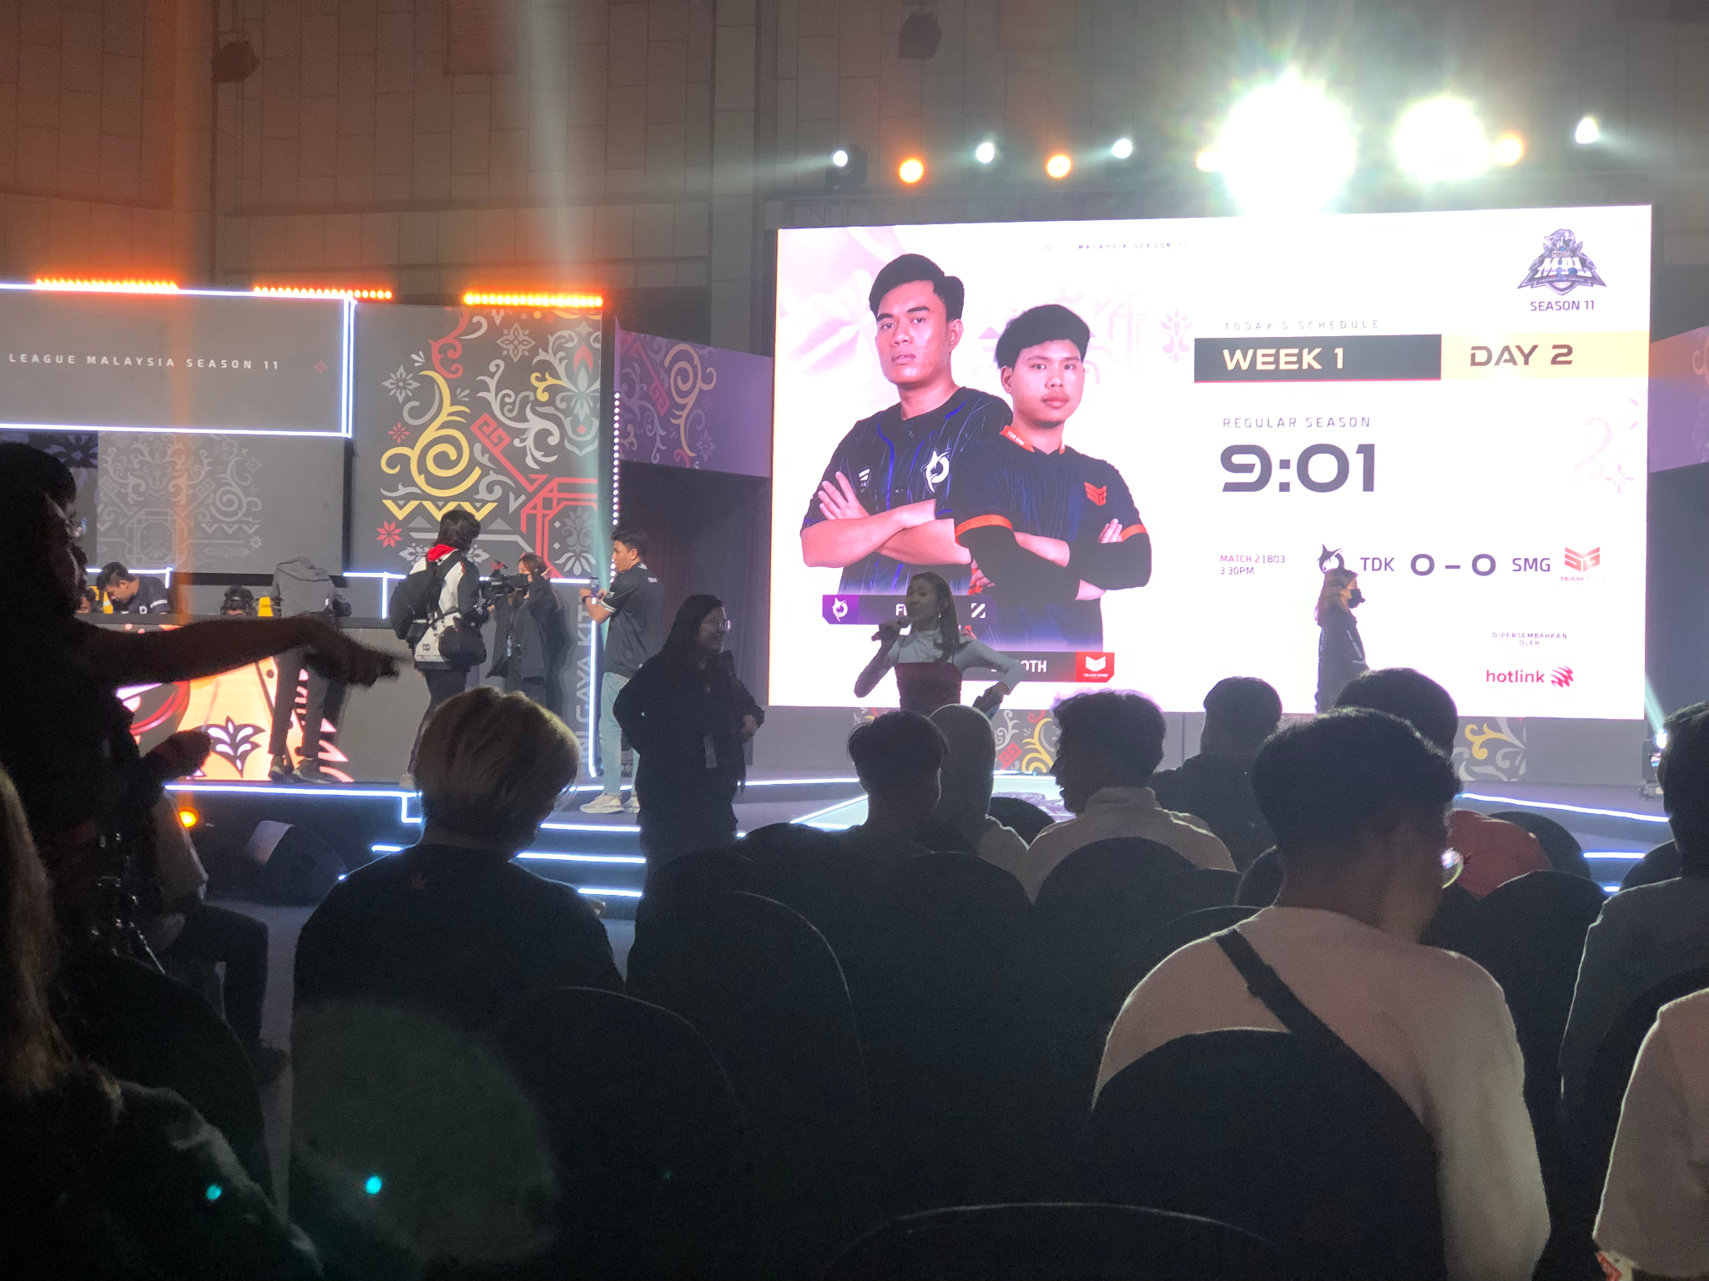

Slide 44
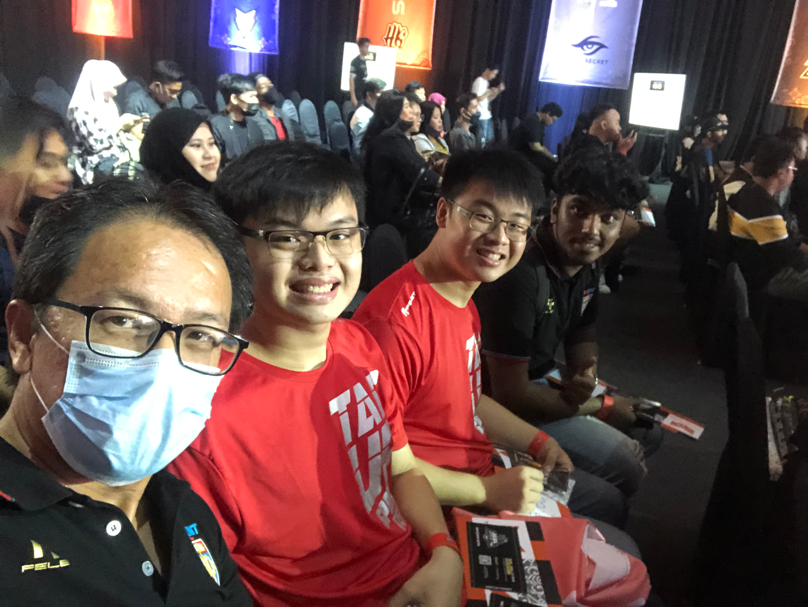

Slide 45
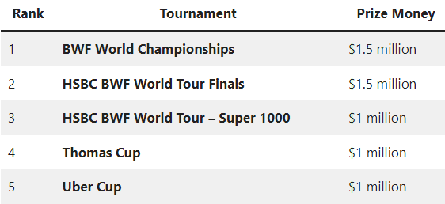
ESPORTS IN FUTURE
OPEN FOR ALL - First ever China Team joining MLBB in M5
https://www.myesportsawards.com/#categories
More games, more teams, more sponsors, more cash prize!
M1 - USD250K (RM1.19mil)
M2 - USD300K (RM1.42mil)
M3 - USD800K (RM3.79mil)
M4 - USD800K (RM3.79mil)
M5 - USD900K (RM4.27mil)

Slide 47
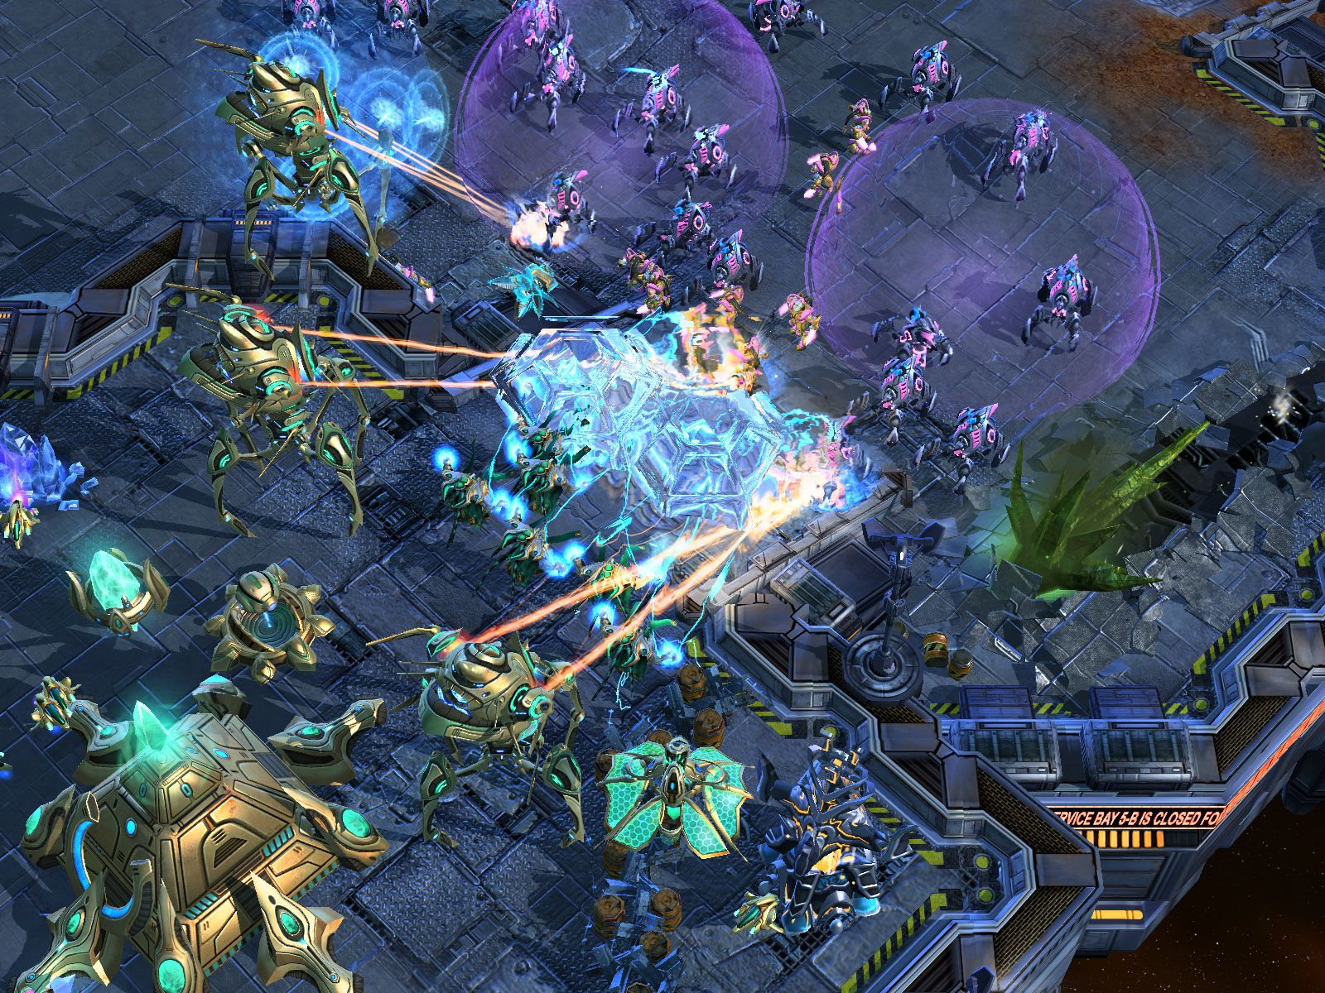
Genres of Esports
1. RTS (Real Time Strategy) - In this type of game, players are tasked to build a base, create an army, and eliminate the other player’s base to achieve victory.
Example:
Starcraft, Starcraft 2, Warcraft 3, Company of Heroes etc.

Slide 48
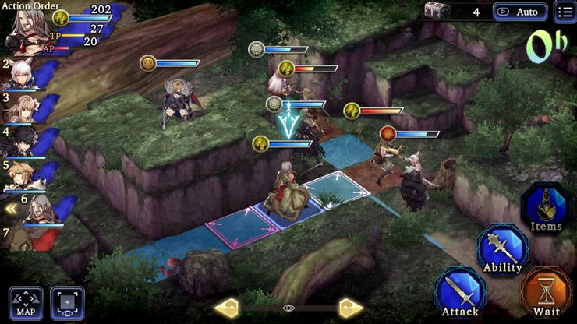
2. RPG (Role Playing Game)
Players choose a character to play the game through the life of that character. Players are able to choose quest lines, hair color, weapons, armor, and numerous other items to make the game more immersive.
Example: Final Fantasy, Witcher, Elder Scrolls Oblivion, Dungeons and Dragons and Fallout etc

Slide 49
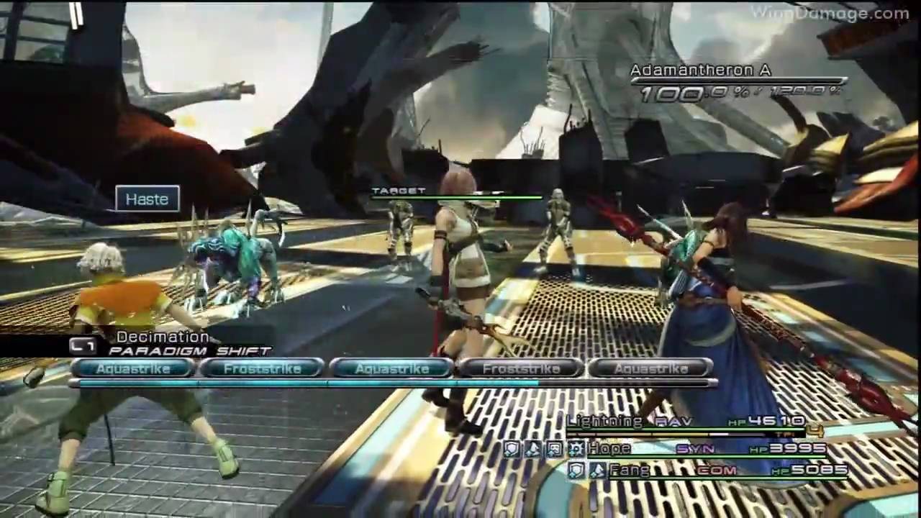

Slide 50
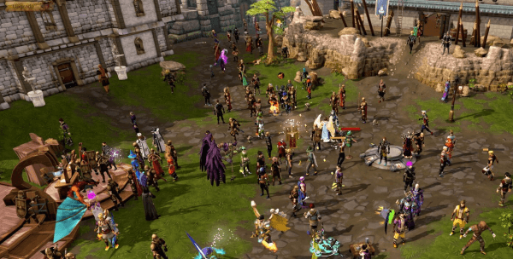
3. MMORPG (Massively Multiplayer Online Role Playing Game)
Similar to other RPGs, this type of game allows players to interact online with other players. Many players make online friendships and join guilds or clans as a result of these games.
Example: World Of Warcraft, Elder Scrolls Online, Lord of the Rings online, Eve Online, Runescape etc.

Slide 51
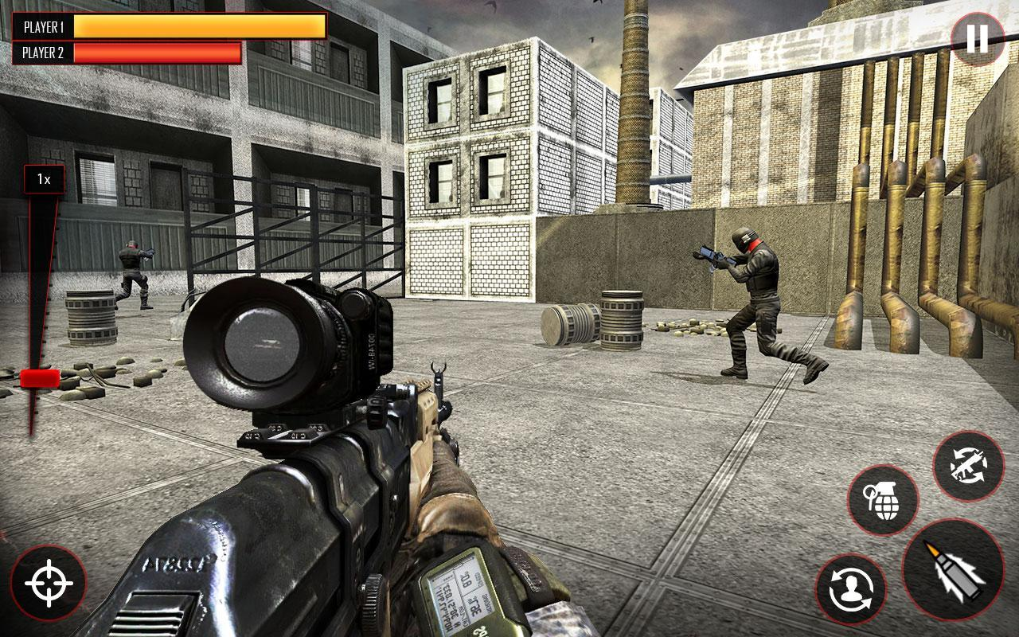
4. FPS (First Person Shooter)
These are available in single and multiplayer varieties. In the single player
version, a player typically participates in a campaign until it is completed. In the multiplayer version, players compete online against other players from across the region or world.
Players are typically trying to capture objectives and hold them for a certain amount of time and eliminate as many other players as possible.
Example: Call of Duty, Overwatch, Battlefield, Grand Theft Auto, CSGO, FIFA, PES etc.

Slide 52
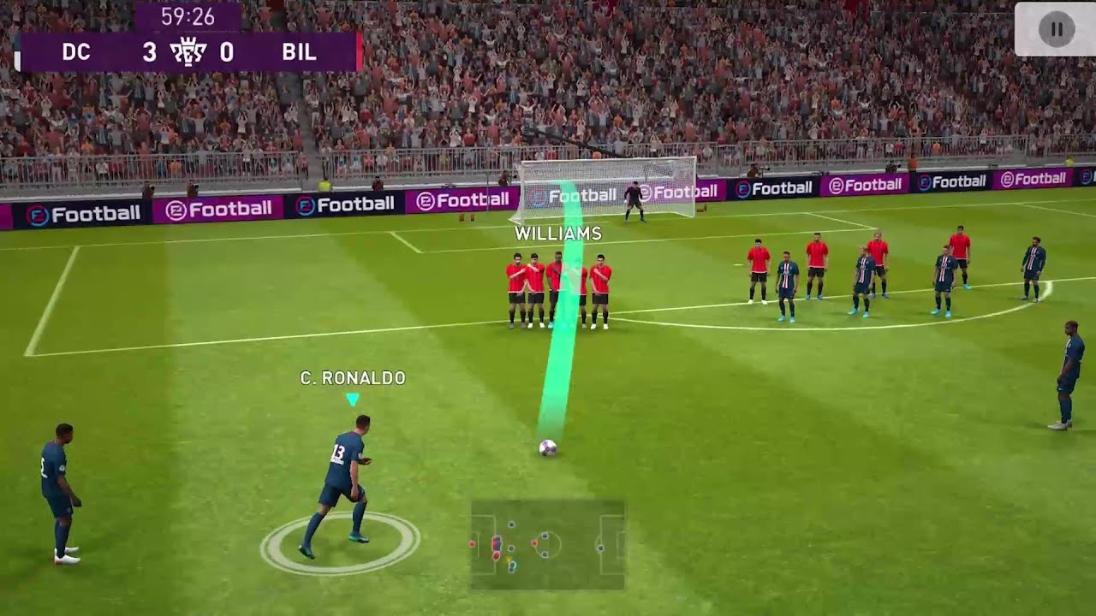

Slide 53
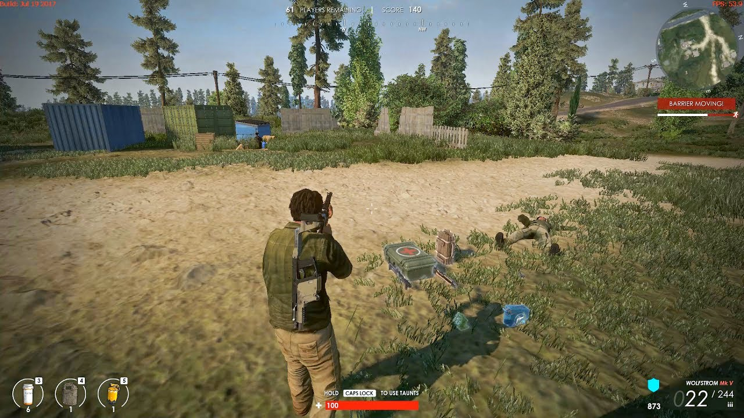
5. Battle Royale
These types of games drop players into a battleground in which they have to locate resources to build shelter and weapons to defeat other players. Typically 64-100 players begin the game,
and there is only one winner per match. Some FPS games are beginning to place Battle Royale game modes within their own games, making it a very popular form of game mode.
Example: Fortnite, Player-Unknown Battlegrounds (PUB-G) etc.

Slide 54
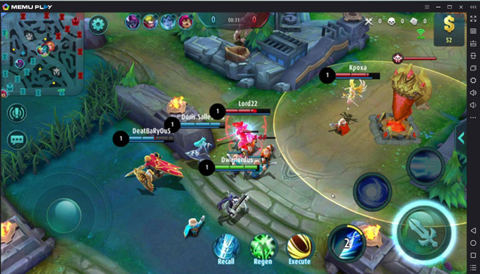
6. MOBA (Multiplayer Online Battle Arena)
This type of game typically involves two teams of 3-5 players on each team. Players choose a character that has a variety of different skills from other characters. As players level up in the game, their characters gain more skills and abilities, while becoming more powerful.
Typically, there is a core or main tower that needs to be destroyed in order for one team to
achieve victory.
Example: League of Legends, Smite, Heroes of the Storm, Arena of Valor, Honor of Kings, Mobile Legends.

Slide 55
Game Play and In-Game Features
Moba takes two teams of players, from 3v3 to 6v6, and place them within an arena in which they select characters to outfight and outwit the enemy team. Mobas boast some of the greatest complexity and highest learning curves of any games. The most popular games in this genre boast over a hundred different playable characters and different playstyles for each. The largest factor for the difficulty of mobas is the vast number of interactions and information to consider within the game.
These games have some of the largest player bases of any game type, as well as the largest and most established esports tournaments.
Mobas require skills that I believe are transferable to real life. These games are not necessarily highly mechanically difficult, but deal heavily with information control, instant decision making, and flexible strategies.
But progress happens by taking a critical look at things that could be improved in their own play. Learning to control emotions and perform consistently is one of the challenges of mobas and interacting anywhere else.

Slide 56
They can bring out the friendliness in people that creates relationships thousands of miles apart
The way people interact feels so real, and improving at this game exemplifies playing nice with strangers.
There is an added dimension to the game when communication between teammates is added to the equation. It would allow teams to cooperate better and would lead to more competitive games. They could communicate strategy and actions with each other and raise their heights to another level.
MOBA delivers practical experience for many types of communication that are useful in life and the workplace being collaboration, constructive criticism, and respectful disagreement.
Establishing a positive learning cycle is essential to improving quickly. Many skills and learning habits follow through these games and may help students in real life, from self-care to coding styles.

Slide 57
Teaching Platforms - Mobile Legends: Bang Bang (MLBB)
Small screen games for the world’s biggest market.
The explosive popularization of smartphones and tablets has proved disruptive to all other
market segments. Its ability to reach millions of people worldwide has made mobile gaming
one of the fastest growing categories in the industry today.
Total Characters - https://mobile-legends.fandom.com/wiki/List_of_heroes
In-game Duration
Early Game: 15 - 20 mins (3 Build Items acquired)
Mid game: 20 - 25 mins (5 Build Items acquired)
Late game: Above 25 mins (7 Build Items acquired)

Slide 58
 |  | OS | RAM | Processor | Storage | Graphic card
1. | MOBILE LEGENDS (MLBB) | Android 4.0 /iOS 9.0 | >1 GB | 4-core 1.2 Ghz | <1 GB | -
2. | League of Legends (LoL) | Android 4.4 /iOS 9.0 | 4 GB | 4-core 1.5 Ghz | >3 GB | -
3. | Arena of Valor | Android 4.4 /iOS 9.0 | 2 GB | 4-core 1.2 Ghz | 3 GB | -
4. | Honor of Kings | Android 4.4 /iOS 9.0 | 2 GB | 4-core 1.2 Ghz | 3 GB | -
5. | DOTA2 | Windows 7 | 4 GB | 2-core 2.8 Ghz | 15 GB | nVidia GeForce 8600/9600GT, ATI/AMD Radeon HD2600/3600

Slide 59
Introduction to the Esports Industry
E-sports continues to rise in popularity and offers a tool for science and academic resources. They are an opportunity to study topics like strategic decision making and management training.
It is important for students and teachers to remain aware of what trends are becoming popular in the industry and how those trends can be used to further enhance student performance during and after their study.
Learning Outcomes
Displays persistence in learning new games.
Differentiates between intrinsic and extrinsic reasons for participating in e-sports.
Integrates e-sport meaningfully into daily life.
Reflects on reasons for choosing to participate in Esports.

Slide 60
Learning Concepts
Demonstrates understanding of movement concepts, principles, strategies, and tactics as they apply to the learning and performance of specific games.
Select and use appropriate offensive and defensive skills in a variety of individual, dual, and team activities.
Demonstrate the ability to safely and comfortably adapt to environmental conditions in a variety of gaming pursuits.
Apply, analyse, and evaluate the tactical decisions within game strategies used in performance.

Slide 61
Game-based Training
> Develop essential skills required in competitive gaming of the subject matter and learning about the esports ecosystem.
> Build, understand, strengthen game knowledge and introduce esports ecosystem.
> Improve individual play styles and acquiring the right skills to become pro gaming athlete. > Train and maintaining game senses, reflexes and strategies.
> Develop understanding of team dynamics, effective teamwork, sportsmanship, positive play ethics and game winning conditions.
> Develop a range of soft skills such as discipline, leadership, perseverance, critical thinking, decision-making, problem- solving, communication and others.

Slide 62
Esports Ecosystem
History of Esports
Understanding the Esports Ecosystem
Esports Business Ecosystem
Marketing in Esports
Project Management in Esports
Content & Media in Esports
Production and Broadcasting in Esports
Technology in Esports
Organizational Culture in Esports
League and Game Operations in Esports
Legal Boundaries in Esports
Monetization and Sustainability in Esports
Obtain project management skills and tools to initiate, plan, execute and close an Esports live event

Slide 63
The Benefits Of Esports
Many of the concerns about healthy screen time use arise from a lack of balance rather than evidence that video games are harmful in and of themselves. In fact, there are also many benefits to structured esports programs, including the following:
• Improved self-esteem.
• Better hand-eye coordination.
• Improved visual-spatial reasoning.
• Meaningful social interaction for students who would otherwise be playing at home.
• Improved learning outcomes through participation in extracurricular activities.
• Scholarship and travel opportunities.

Slide 64
How Esports Support STEM Learning
A well-planned esports program can indeed support STEM learning in a variety of ways. In particular, it encourages:
• Teamwork for problem-solving: Teammates quickly learn to treat losses as opportunities to solve problems and improve performance, turning to a growth mindset rather than embracing the idea that success is about innate talent.
• Scientific methodology: As players work to figure out a game, their thinking becomes more systematic as they develop and test hypotheses to improve play.
• Using data and evidence: Esports players gather data on timing and probability to plan faster speed runs, maximize the odds of finding in-game bonuses and generally fine-tune performance based on hard evidence.
• Technological proficiency: Students use more than just game controllers and consoles. They also film players, edit sound and video, publish tutorials, connect online, and develop programs to manage their meetings, data and more.
• Resources For Doing Esports Right

Slide 65
When organized well and designed as a cross-curricular activity for a wide range of students, esports has the potential to bring students together, enhance learning and mitigate technological inequities for students with fewer resources. There are several parties working to bring robust esports programs to schools everywhere by offering curriculum, support and community:
Structured esports offerings have the potential to build inclusive, pro-social environments that can facilitate sound educational outcomes in an exciting way. Pairing esports with STEM education can help students reach their full potential.

Slide 66
Goal-Setting and Decision-Making Skills
Most video games of today aren’t one-time play and win games. Players level up and
the more they play the higher their ranking. By setting goals, players not only measure their practiced improvement, but setting goals also helps players to monitor as well as limit or increase playing time according to goal success.
The student will demonstrate the ability to use goal-setting and decision-making
skills to enhance gaming success. The ability to utilise various strategies when making decisions related to gaming scenarios as well as personal experiences.
They need to develop an action plan to obtain goals by utilising various decision-making models through a gaming scenario. Hence, they may determine which strategies are most conducive to certain situations.

Slide 67
2. Strategic thinking and planning
Sports require students to set goals, assess the competition and consider their individual strengths and weaknesses. As a member of a team, students learn to establish tactics, put together game plans and adjust execution as needed. Thinking quickly and strategically is part and parcel of any sport.
3. Team Building, Effective Communication
Players need improvement plans to improve their gameplay. Apart from a few aspects of play, such as mechanical ability and positioning, improvement is closely tied with working with fellow players.
The goal should be to help students analyze game data and break it down so that they communicate the strategy to others in a positive and helpful way.
Simply practicing the mechanics of the game are not the only skills that make teams successful. Communication is also one of the keys to success.

Slide 68
Realize the teamwork, compromise, communication, and problem solving that goes into competitive eSports, especially when playing team games. It will also highlight the problems that pop up if any team member refuses to cooperate, creating a dilemma for the others.
Working with others. working well with others requires the development of countless additional skills like communication, assertiveness, and compromise. Conflict management, active listening, and respect.
Provide appropriate support for a teammate in a team activity.
Provide a variety of team-building activities that promote interaction between team members.

Slide 69
4. Interpersonal Communication (Personal and Social Behavior)
The student will demonstrate the ability to use interpersonal communication
skills that respects self and others in online gaming settings.
Gamers respond to many different players and ingame characters while navigating ever-changing obstacles and scenarios. Being able to adapt and think quickly as well as communicate their strategies both verbally and nonverbally are all skills that gamers must have.
In this lesson, students will practice thinking quickly and communicating to their teammates in a non-competitive environment. In addition, students will understand that gaming skills can be learned and perfected.
Assign an effective communication activity and role play active-listening skills.

Slide 70
5. Managing success and failure.
Learning to manage the emotions of losing and winning, helps kids become resilient.
Conflicts appear during the course of the game and one of the most important aspects of mobas is the way players deal with these interpersonal conflicts.
6. Promote healthy gaming habits
Online gaming culture can sometimes be toxic.
Examples include racist trash-talking, explicit comments when a female enters voice chat, and bullying teammates over perceived failures.
Toxicity has pushed many players away from some of their favorite games, as the fun of mastering the mechanics is quickly soured by rude comments or typing angry lines of abuse.

Slide 71
7. Gaming Appreciation
Values gaming for health, enjoyment, challenge, self-expression, and social interaction.
One of the downfalls of online gaming can be the toxic environment that sometimes exists. Students will reflect on real-life toxic experiences and brainstorm how to handle and prevent them from happening.
“Code of Behavior”
Establishes expectations and boundaries for students and clarifies what is and what is not acceptable gaming behavior.
Identify positive behavior and establish strategies to promote positive behavior.
Encourage others to apply appropriate etiquette in all online gaming settings.
Showcase great sportsmanship by respecting teammates and opponents as well.
Demonstrate empathy skills and appropriately respond to both success and disappointment.
Language may affect the outcome of the game and others' attitudes. Demolish toxic behavior in games.

Slide 72
8. Health Promotion and Preventative Care for Gamers
The student will comprehend concepts related to health promotion and preventative
care in gamers as related to the following content areas
i) Nutrition
ii) Injury prevention
Although gaming may not be the job for the student currently, it is still good to understand and practice the guidelines established by OSHA to instill good habits that can prevent injury.
There is a lack of regulation in terms of the mental and physical health of players. It is important to accept e-sports as a viable field and introduce the same health standards that we have for other sports and professions.
a) Neck, Arms & Wrist Exercises
Anyone who experiences prolonged use of a computer can benefit from wrist stretches and wrist exercises to help avoid carpal tunnel or tendonitis.

Slide 73
b) Personal health
Students to discern the need for healthcare through breathing, muscle relaxation, and imagery management techniques.
Identify and practise strategies to manage stress.
Analyse short-term and long-term consequences of safe, risky, and harmful behaviors and recognise one's responsibility for self-management.
c) Mental and emotional health
Since the course of the games relies on a team of players working together towards the common goal of victory, the mental state of each of the players has a huge impact on the game result.

Slide 74
Analyse how behavior can impact health promotion and preventive care in players.
Describe the importance of the interrelationships of mental, emotional, social, and physical health through e-sport.
Analyse how public policies, e-sports governing bodies, and stakeholder communities impact the health promotion and preventive care in players.
d) Substance abuse, misuse, abuse, and addiction
Instill pro-social values for all participants.
Principles and standards of behavior like good sportsmanship, fairness, and respect. Persistence, honesty, fun and healthy competition. These values can buoy participants throughout their lives.

Slide 75
References:-
Multiplayer online games: origins, players, and social dynamics. Freeman, Guo. 2018. Boca Raton, FL: CRC Press.
Game plan: great designs that changed the face of computer gaming. Curran, Ste. 2017. Switzerland: RotoVision.
Raising the stakes: e-sports and the professionalization of computer gaming. Taylor, TL. Cambridge, Mass: MIT Press.2012
A to Z world sports: 175 countries - individual sSports participation, private sports clubs, school sports, professional sports, major spectator sporting events. Sibylla Putzi, 2018. Petaluma: World Trade Press.
Sports videogames. Consalvo, Mia. 2013. New York; Oxfordshire, England: Routledge
Playing to win: sports, video games, and the culture of play. Brookey, Robert Alan. 2015. Bloomington: Indiana University Press.
Innovation and strategy of online games. Jong, H. Wi. 2009. London: Imperial College Press.
eSport management: embracing eSport education and research opportunities. Funk, Daniel C. 2018. Sport management review: ScienceDirect Freedom Collection 2020.

Slide 76
Component | Overall % | Description | Breakdown % | Remarks
Attendance | 20 | 11 + 3 (coqday) | 100 | Must fulfill attendance
Log book | 20 | Submission by session 8 | 100 | Late submission minus mark
Skill Test 1 - Quiz & Presentation | 20 | Quiz (25 MCQ) | 50 | Session 10
 |  | Group presentation | 50 | Session 9
Skill Test 2 - Practical | 20 | 6 Custom games | 50 | Total score of 6 games (capped at 50)
 |  | 6 Classic games | 50 | Total score of 6 games (capped at 50)
Involvement | 10 | Commitment & attitude | 100 | Bonus
Achievement | 10 | Competition | 100 | CoQ Day (4 hours)

Slide 77
1. Which of the heroes below is NOT a tank?
(a) Hylos (b) Baxia (c) Balmond (d) Esmeralda
2. How many times ‘death sonata’ fired by marksman, Granger for its Ultimate?
(a) 1 (b) 2 (c) 3 (d) 4
3. How many golds in total awarded to teammates once took down the cyroturtle?
(a) 600 (b) 800 (c) 1000 (d) 1200
4. How many heroes in total can be banned during draft pick in ranked mode?
(a) 3 (b) 4 (c) 5 (d) 6
5. In which menu players can set the heroes’ build items on main interface?
(a) Preparation (b) Leaderboards (c) Achievements (d) Inventory

Slide 78
Members need to explain his/her role with their hero in the scenario when presenting the game META video clip in class (10%) :-
What is your strategy to counter AOE, Stun & High Damage skills?
How is my team combo skills work together to sustain the war?
For example:-
My Team (1st to Pick) My Opponent
Ban: Matilda, Beatrix, Faramis Ban: Pharsa, Saber, Arlott
1st Yve 1st Harith
2nd Akai 2nd Hylos
3rd Yu Zhong 3rd Lunox
4th Clint 4th Brody
5th Angela 5th Lapu-lapu

Slide 80
Types of Specialty in Mobile Legends
namely Regen, Crowd Control, Reap, Charge, Push, Damage, Burst Damage, Poke, and Initiator.
REGEN
Heroes with this Specialty have the ability to regenerate HP itself and hero in your team.
Rafaela, Estes and Angela have the skills to self-regulate and hero the team
Hilda, Balmond, and Alice have a skill that can self-regulate.
These heroes can be relied upon to maintain the tower, or become the ever-present support when needed.
Rafaela and Estes are very useful for improving team resilience when having to do war or push a tower.
CROWD CONTROL (CC)
Disrupt the crowd or bumping up the hero of the opponent who is gathered by giving slow effects, stun and other effects.
Tigreal, Johnson, Balmond, Akai, Alucard and many more.

Slide 81
REAP
Harass and prevent opponents from farming.
Marksman and assassin.
Nana, Clint, Eudora, Yi Sun-Shin, Fanny, Saber, and Karina.
Very efficient when going team fight.
Hero with Reap is tasked to "finish" the enemies who are dying or fleeing.
CHARGE
To catch the enemy or start a team fight with a fast skill like jumping and moving fast forward.
Zilong, Saber, Fanny, Alpha, Akai, Alucard, Freya, Hayabusa, and Natalia.
PUSH
Have an advantage when doing push towers in which can do alone.
Remove soldiers and have a considerable damage.
Excellent self-made ability to finish minions and gang up on turrets.
Zhask, Sun

Slide 82
DAMAGE
Has a longer duration of damage.
Good at harassing enemies, reducing HP's opponents consistently, bit by bit.
Very superior in the laning phase, where everything is still cautious in exchanging attacks.
Eudora, Gord, Kagura, Cyclops, Hilda
BURST
Burst damage has quite a span of time.
Suitable to fight enemy heroes who have a small HP because the hero is able to kill off enemy HP quickly in a short time.
Moskov, Assassins
POKE
Use of a little, but has a considerable damage.
Estes, Yi Sun-Shin, Cyclops, Nana
INITIATOR
in charge of opening the fight.
Tank type heroes because they are on the front line.
Tigreal, Franco, Minotaur

Slide 83
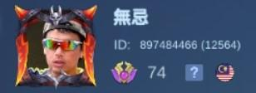
ROLE TYPES OF HERO
Roamer - Tank, Support, <Mage
Jungler - Assassin, Fighter, Tank, <Marksman, <Mage
Midlaner - Mage, Support
Goldlaner - Marksman, <Mage
Offlaner /EXPlaner - Fighter, Tank

Slide 84

Jungling
Retribution spell in MLBB:-
Deals 520 (+80 × Hero Level) True Damage to a creeps and minions. Passive: Creep rewards are increased by 60%, and damage taken from creeps is reduced by 50%. Minion rewards are reduced by 70% for the first 5 minutes.
It allows the hero to deal true damage to jungle creeps while simultaneously reducing the damage received from them.
It increases the gold and experience rewards obtained from defeating these creeps, allowing for rapid farming during the early to mid stages of the game.
Could amplify its effectiveness as you accumulate five creep kills or assists, upgrading the spell based on your chosen type of blessing.
These blessings come in three distinct variations — Ice, Flame, and Bloody — each offering unique effects when cast against enemy heroes.

Slide 85
Retribution - ICE
Ability
Damage dealt to creeps or minions is increased to 150%. Can be used against heroes, dealing 100 True Damage and absorbing 72-100 Movement Speed from the target over 5s (scales with level).
Only when total creep kills, hero kills, or hero kill assists reach 5 can Retribution be upgraded.
Allows you to steal movement speed from your target depending on your level for several seconds, making you agile while slowing them down.
Use against opponents are highly mobile, particularly their mage or marksman. Jungler can easily chase them down to secure a crucial kill or escape from them when getting pursued.
Ice Retribution works great for most assassin junglers, including Ling, Lancelot, Gusion etc

Slide 86
Ability
Dealing 100 True Damage and absorbing 35-70 Physical Attack and Magic Power from target over 3s (scales with level).
It strongly enhances your chance of being dominant in 1v1 situations or securing a pickoff.
Use this if your team possesses a significant amount of crowd control spells, and you need to burst down an enemy as fast as possible.
Heroes such as Hayabusa, Saber, Helcurt etc significantly benefit from the special effect by Flame Retribution.
Retribution - FLAME

Slide 87
Ability
Dealing 100 True Damage and absorbing HP equal to 12% of the hero Max HP from target over 3s (scales with level).
Good for tank jungler who is prioritizing items that significantly increase your HP. You can inflict huge DPS to your target and absorb more incoming damage to protect your allies.
Example of junglers like Barats, Fredrinn, Alice, tank Lancelot, Karina, Harley etc
Retribution - BLOODY

Slide 89
HOUSE RULES
CAN’T SPEND MONEY FOR THE GAME
(such as buying new hero, skins, campaign items etc.)
ALWAYS AVOID TOXICITY BEHAVIOUR IN CLASS.
(verbal or written abuse in game or out of the game)
1st Week Mission
Obtain basic heroes in a week thru campaign.
(Layla, Eudora, Tigreal, Zilong, Balmond)
Collect Battle Points & Tickets by completing daily tasks
in order to purchase new hero (Low Mechanic).
Collect Magic Dust to upgrade BASIC EMBLEM.
Skins, emote etc are not significant but Quick Chat yes.

Slide 90
Training a new Hero
FOR BEGINNER
Read & Understand their skills.
Go Hero Training mode, set Max Level & No CD.
Play VS AI - Classic. Hard mode.
Aim to get GOLD medal.
FOR ADVANCED (Mythic+)
Read & Understand their skills. (Gusion, Lancelot, Hayabusa, Ling, Fanny)
Go Hero Training mode, set Hard mode, Max Level & No CD.
Play VS AI - Classic under Hard mode.
Aim to be MVP.

Slide 91
GAME SETTING - DEMO -
Network Latency (Telco, Wifi, Hybrid)
2) Graphic for Quality or Speed?
3) Basic Attack Controllers
4) Aim Target by Proximity, Lowest HP or HP%
5) Pan Aiming for widen aerial view?
Wifi password cc103G esp1155668
RED
LAPU-LAPU
LUNOX
NOVARIA
HANZO
ROGER
BLUE
JULIAN
BANE
GRANGER
GUSION
SELENA

Slide 92
MAPS ENVIRONMENT
- DEMO -
SIKLONE EYES (40s up, 30s CD)
Thick & Thin Walls
Magic Sentry (90s CD)
1 inner turret destroyed
Give vision to the area for a short time
Bushes
Turrets (Base/Inhibitor, Inner, Outer)
Minions wave (200 Gold)
CC103G Wifi password esp1155668
RED
BALMOND
BADANG
GLOO
SILVANNA
Granger/Beatrice/KARIE
BLUE
ALICE
KAGURA
KUFRA
ALUCARD
BAXIA

Slide 93
MAPS ENVIRONMENT
- DEMO -
SIKLONE EYES (40s up, 30s CD)
Thick & Thin Walls
Magic Sentry (90s CD)
1 inner turret destroyed
Give vision to the area for a short time
Bushes
Turrets (Base/Inhibitor, Inner, Outer)
Minions wave (200 Gold)
CC103G Wifi password esp1155668
RED
LUO YI
ROAMER
JUNGLER
FIGHTER
MARKSMAN
BLUE
PHARSA
YU ZHONG
ANGELA
FIGHTER
MARKSMAN

Slide 94
MAPS ENVIRONMENT
- DEMO -
SIKLONE EYES (40s up, 30s CD)
Thick & Thin Walls
Magic Sentry (90s CD)
1 inner turret destroyed
Give vision to the area for a short time
Bushes
Turrets (Base/Inhibitor, Inner, Outer)
Minions wave (200 Gold)
CC103G Wifi password esp1155668
RED
BALMOND
BADANG
ALUCARD
SILVANNA
KARIE
BLUE
ALICE
KAGURA
GUSION
BAXIA
GRANGER

Slide 95
MAPS ENVIRONMENT
- DEMO -
SIKLONE EYES (40s up, 30s CD)
Thick & Thin Walls
Magic Sentry (90s CD)
1 inner turret destroyed
Give vision to the area for a short time
Bushes
Turrets (Base/Inhibitor, Inner, Outer)
Basic attack only!
Minions wave (200 Gold)
CC103G Wifi password esp1155668
RED
ZILONG
BADANG
ALUCARD
SILVANNA
BEATRIX
BLUE
MARTIS
SUN
GRANGER
GUSION
LAYLA

Slide 96
MAPS ENVIRONMENT
- DEMO -
SIKLONE EYES (40s up, 30s CD)
Thick & Thin Walls
Magic Sentry (90s CD)
1 inner turret destroyed
Give vision to the area for a short time
Bushes
Turrets (Base/Inhibitor, Inner, Outer)
Basic attack only!
Minions wave (200 Gold)
CC103G Wifi password esp1155668
RED
ZILONG
BADANG
ALUCARD
SILVANNA
BEATRIX
BLUE
MARTIS
SUN
GRANGER
GUSION
LAYLA

